Slide 1
Week 7
Çizim Programlarından Model Yükleme&Ekran Kordinatları&Seçme&daha fazla…

Slide 2
void cub2a(void)
{
// 1797 Verticies // 3590 Triangles
static short face_indicies[3590][3] = {
// Object #-1
{0,1,2 }, {3,4,5 }, {6,7,8 }, {9,10,11 }, {12,13,14 }, {15,16,17 },
{18,19,20 }, {21,22,23 }, {24,25,26 }, {27,28,29 }, {30,31,32 },
{33,34,35 }, {36,37,38 }, {39,40,41 }, {42,43,44 }, {45,46,47 },
………………………………………………………………….
{572,121,137 }, {1110,450,449 }, {472,471,804 }, {707,476,1139 },
{1387,1512,1722 }, {1067,1151,1672 }
};

Slide 3
static GLfloat vertices [1797][3] = {
{2343.77f,439.085f,391.158f},{2325.88f,433.552f,348.301f},{2332.91f,446.989f,373.731f},
{2357.64f,488.039f,573.044f},{2355.86f,493.122f,542.625f},{2350.15f,505.026f,566.762f},
{2200.48f,373.699f,673.503f},{2207.93f,361.565f,656.069f},{2212.43f,374.36f,678.691f},
………………………………………………
{2041.29f,497.122f,407.205f},{1997.29f,493.668f,142.1f},{1985.73f,701.398f,679.446f},
{2124.24f,451.877f,753.635f},{1947.79f,603.404f,698.297f},{2093.41f,540.321f,807.312f}
};

Slide 4
float normals [576][3] = {
{0.0f,0.0f,-1.0f},{0.0f,0.0f,-1.0f},{0.0f,0.0f,-1.0f},
{0.0f,0.0f,-1.0f},{0.0f,0.0f,-1.0f},{0.0f,0.0f,-1.0f},
{0.0f,0.0f,-1.0f},{0.0f,0.0f,-1.0f},{0.0f,0.0f,-1.0f},
………………………………………………………
{-1.0f,0.0f,0.0f},{-1.0f,0.0f,0.0f},{-1.0f,0.0f,0.0f},
{-1.0f,0.0f,0.0f},{-1.0f,0.0f,0.0f},{-1.0f,0.0f,0.0f},
{-1.0f,0.0f,0.0f},{-1.0f,0.0f,0.0f},{-1.0f,0.0f,0.0f}
};

Slide 5
glBegin (GL_TRIANGLES);
for(i=0;i<sizeof(face_indicies)/sizeof(face_indicies[0]);i++)
{
for(j=0;j<3;j++)
{
vi=face_indicies[i][j];
ni=face_indicies[i][j+3];//Normal index
glNormal3f (normals[ni][0],normals[ni][1],normals[ni][2]);
glVertex3f (vertices[vi][0],vertices[vi][1],vertices[vi][2]);
vertices2[vi][0]=vertices[vi][0];
vertices2[vi][1]=vertices[vi][1];
vertices2[vi][2]=vertices[vi][2];
}
}
glEnd ();
}

Slide 6
#include "cub2a.c”
void drawAxes(void)
{
drawwall();
glColor3f(1,0,0);
glPushMatrix();
glPushName(1);
glTranslatef(tsx,tsy,tsz);
glRotatef(angleSphere,rsx,rsy,rsz);
cub2a();
glPopName();
glPopMatrix();

Slide 7


Slide 8
void Normals(vertices *V, triangle *T,vertices *Vn)
{
float v1a[3],v2a[3],normal[3]; int Vtn[NBVERTICES];
for(i=0; i<TRI; i++)
{
v1a[0]=V[T[i].second].x-V[T[i].first].x;
v1a[1]=V[T[i].second].y-V[T[i].first].y;
v1a[2]=V[T[i].second].z-V[T[i].first].z;
v2a[0]=V[T[i].third].x-V[T[i].first].x;
v2a[1]=V[T[i].third].y-V[T[i].first].y;
v2a[2]=V[T[i].third].z-V[T[i].first].z;
normCrossProd(v1a, v2a, normal);
}

Slide 9
Vn[T[i].first].x+=normal[0];
Vn[T[i].first].y+=normal[1]; Vn[T[i].first].z+=normal[2];
Vn[T[i].second].x+=normal[0]; Vn[T[i].second].y+=normal[1];
Vn[T[i].second].z+=normal[2]; Vn[T[i].third].x+=normal[0];
Vn[T[i].third].y+=normal[1]; Vn[T[i].third].z+=normal[2];
Vtn[T[i].first]+=1; Vtn[T[i].second]+=1; Vtn[T[i].third]+=1;
}
for(vrt=0; vrt<NBVERTICES; vrt++)
{
normal[0]=(Vn[vrt].x)/Vtn[vrt];
normal[1]=(Vn[vrt].y)/Vtn[vrt];
normal[2]=(Vn[vrt].z)/Vtn[vrt];
normalize(normal);
Vn[vrt].x=normal[0];
Vn[vrt].y=normal[1];
Vn[vrt].z=normal[2];
}

Slide 10
void normalize(float v[3])
{
float d = sqrt(v[0]*v[0]+v[1]*v[1]+v[2]*v[2]);
if (d != 0.0) /* avoid division by zero */
{
v[0] /= d;
v[1] /= d;
v[2] /= d;
}
}
void normCrossProd(float v1[3], float v2[3], float out[3])
{
out[0] = v1[1]*v2[2] - v1[2]*v2[1];
out[1] = v1[2]*v2[0] - v1[0]*v2[2];
out[2] = v1[0]*v2[1] - v1[1]*v2[0];
normalize(out);
}

Slide 12
Mouse Kordinatları
#include <stdlib.h>
#include <stdio.h>
#include <glut.h>
void display(void) {
glClear(GL_COLOR_BUFFER_BIT);
glFlush();
}
void reshape(int w, int h)
{
glViewport (0, 0, (GLsizei) w, (GLsizei) h);
glMatrixMode(GL_PROJECTION);
glLoadIdentity();
gluPerspective (45.0, (GLfloat) w/(GLfloat) h, 1.0, 100.0);
glMatrixMode(GL_MODELVIEW);
glLoadIdentity();
}

Slide 13
void mouse(int button, int state, int x, int y)
{
GLint viewport[4];
GLdouble mvmatrix[16], projmatrix[16];
GLint realy; /* OpenGL y coordinate position */
GLdouble wx, wy, wz; /* returned world x, y, z coords */
switch (button) {
case GLUT_LEFT_BUTTON:
if (state == GLUT_DOWN) {
glGetIntegerv (GL_VIEWPORT, viewport);
glGetDoublev (GL_MODELVIEW_MATRIX, mvmatrix);
glGetDoublev (GL_PROJECTION_MATRIX, projmatrix);
/* note viewport[3] is height of window in pixels */
realy = viewport[3] - (GLint) y - 1;
printf ("Coordinates at cursor are (%4d, %4d)\n", x, realy);

Slide 14
gluUnProject ((GLdouble) x, (GLdouble) realy, 0.0,
mvmatrix, projmatrix, viewport, &wx, &wy, &wz);
printf ("World coords at z=0.0 are (%f, %f, %f)\n",
wx, wy, wz);
gluUnProject ((GLdouble) x, (GLdouble) realy, 1.0,
mvmatrix, projmatrix, viewport, &wx, &wy, &wz);
printf ("World coords at z=1.0 are (%f, %f, %f)\n",
wx, wy, wz);
}
break;
case GLUT_RIGHT_BUTTON:
if (state == GLUT_DOWN)
exit(0);
break;
default:
break;
}
}

Slide 15
void keyboard(unsigned char key, int x, int y)
{
switch (key) {
case 27:
exit(0);
break;
}
}
int main(int argc, char** argv)
{
glutInit(&argc, argv);
glutInitDisplayMode (GLUT_SINGLE | GLUT_RGB);
glutInitWindowSize (500, 500);
glutInitWindowPosition (100, 100);
glutCreateWindow (argv[0]);
glutDisplayFunc(display);
glutReshapeFunc(reshape);
glutKeyboardFunc (keyboard);
glutMouseFunc(mouse);
glutMainLoop();
return 0;
}

Slide 16
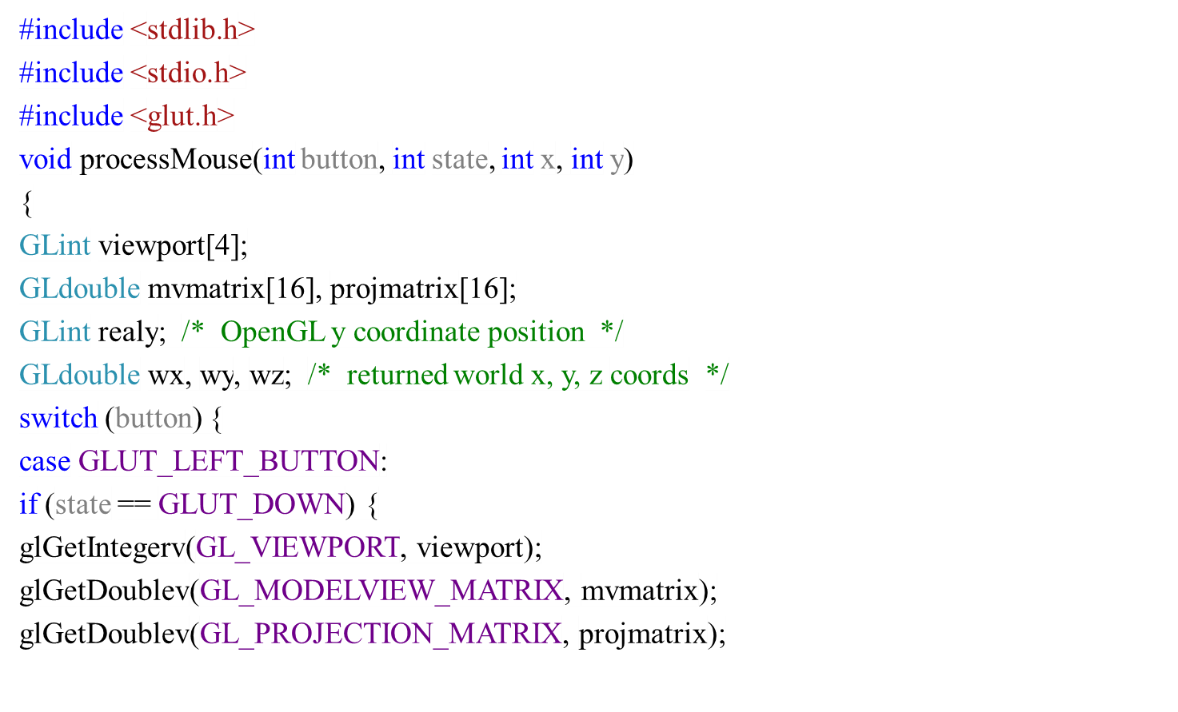
Mouse Kordinatları

Slide 17
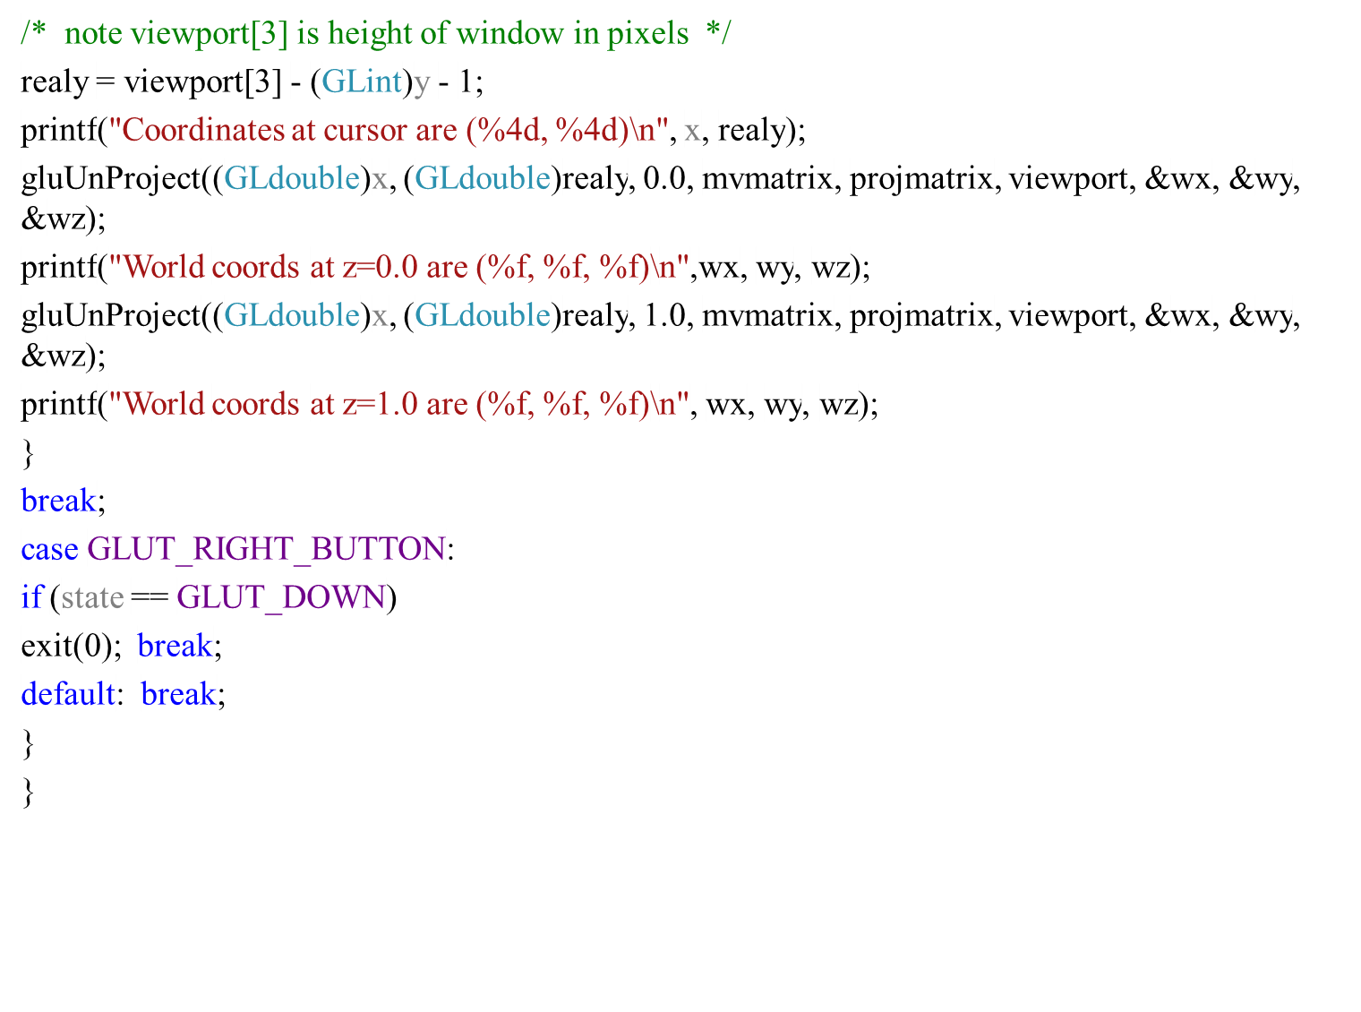

Slide 18
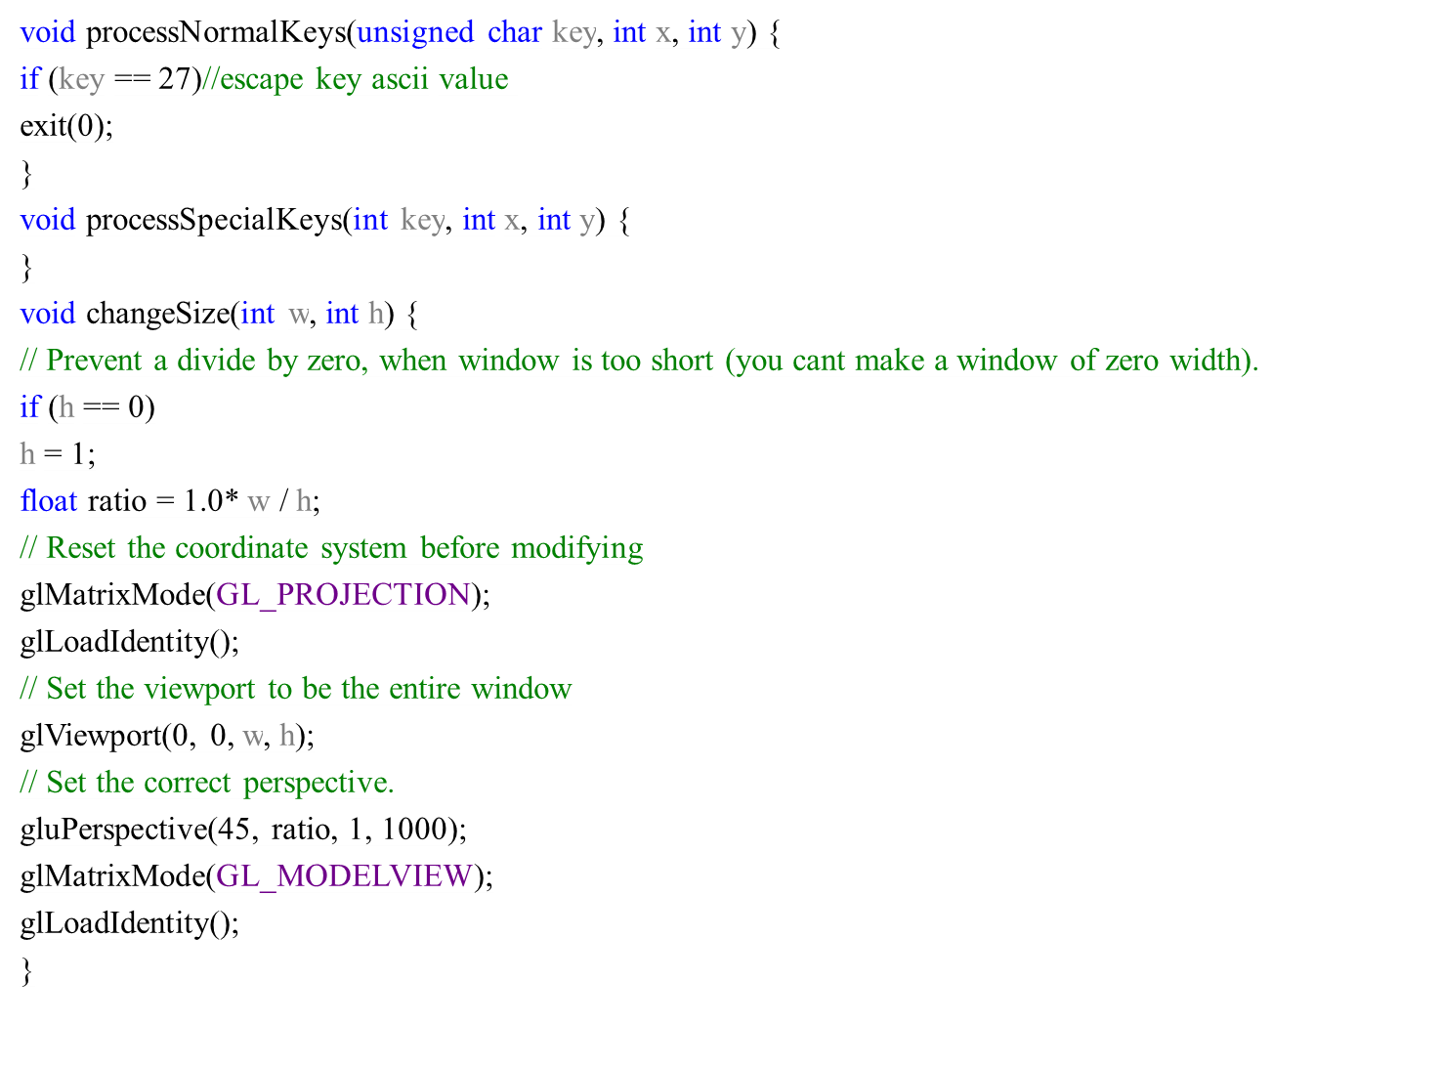

Slide 19
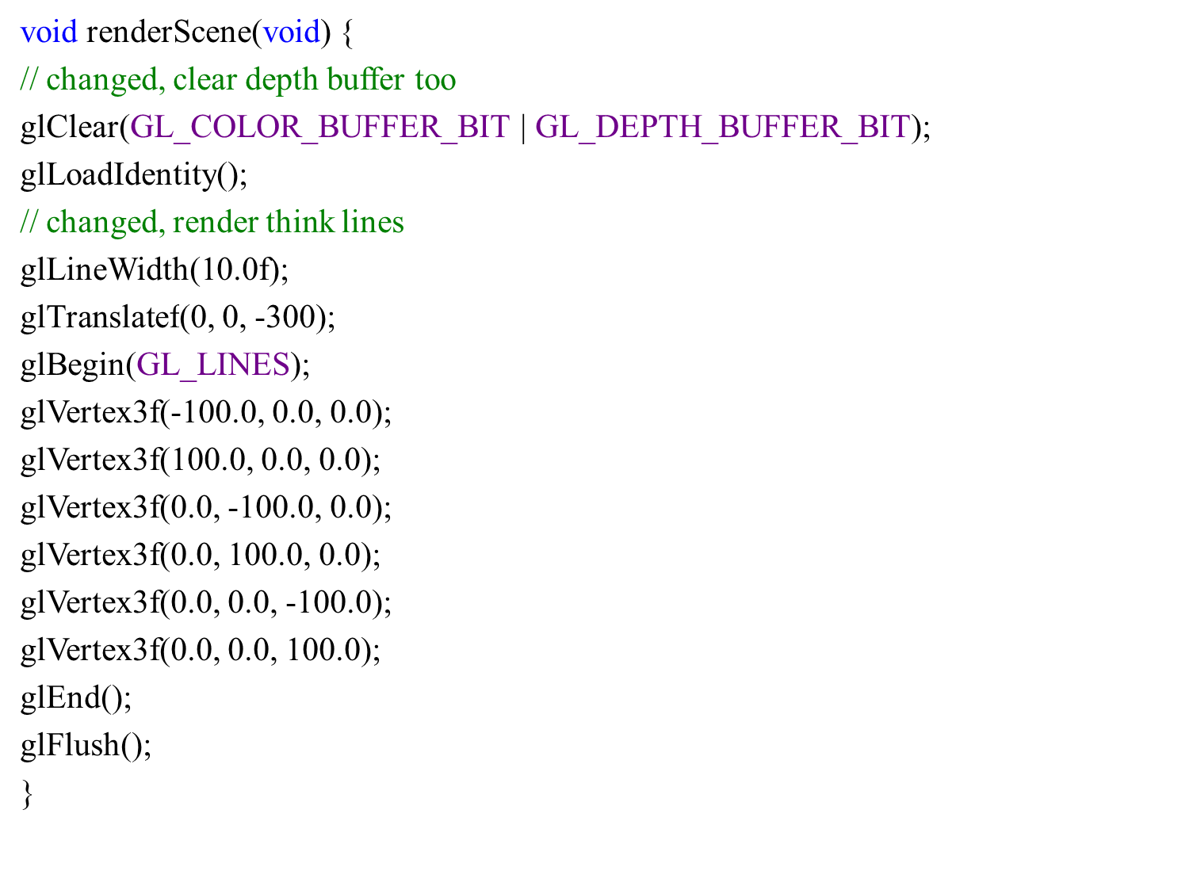

Slide 20
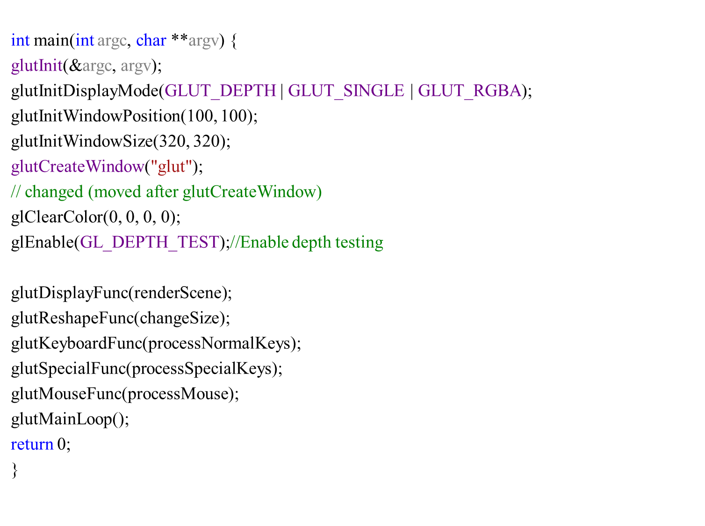

Slide 22
Ekranda seçme
#include <stdlib.h>
#include <stdio.h>
#include <glut.h>
void init(void)
{
glClearColor(0.0, 0.0, 0.0, 0.0);
glEnable(GL_DEPTH_TEST);
glShadeModel(GL_FLAT);
glDepthRange(0.0, 1.0); /* The default z mapping */
}

Slide 23
void drawRects(GLenum mode)
{
if (mode == GL_SELECT)
glLoadName(1);
glBegin(GL_QUADS);
glColor3f(1.0, 1.0, 0.0);
glVertex3i(2, 0, 0);
glVertex3i(2, 6, 0);
glVertex3i(6, 6, 0);
glVertex3i(6, 0, 0);
glEnd();
if (mode == GL_SELECT)
glLoadName(2);
glBegin(GL_QUADS);
glColor3f(0.0, 1.0, 1.0);
glVertex3i(3, 2, -1);
glVertex3i(3, 8, -1);
glVertex3i(8, 8, -1);
glVertex3i(8, 2, -1);
glEnd();
if (mode == GL_SELECT)
glLoadName(3);
glBegin(GL_QUADS);
glColor3f(1.0, 0.0, 1.0);
glVertex3i(0, 2, -2);
glVertex3i(0, 7, -2);
glVertex3i(5, 7, -2);
glVertex3i(5, 2, -2);
glEnd();
}

Slide 24
void processHits(GLint hits, GLuint buffer[]) {
unsigned int i, j;
GLuint names, *ptr;
printf("hits = %d\n", hits);
ptr = (GLuint *) buffer;
for (i = 0; i < hits; i++) { /* for each hit */
names = *ptr;
printf(" number of names for hit = %d\n", names); ptr++;
printf(" z1 is %g;", (float) *ptr/0x7fffffff); ptr++;
printf(" z2 is %g\n", (float) *ptr/0x7fffffff); ptr++;
printf(" the name is ");
for (j = 0; j < names; j++) { /* for each name */
printf("%d ", *ptr); ptr++;
}
printf("\n");
}
}

Slide 25
#define BUFSIZE 512
void pickRects(int button, int state, int x, int y)
{
GLuint selectBuf[BUFSIZE];
GLint hits;
GLint viewport[4];
if (button != GLUT_LEFT_BUTTON || state != GLUT_DOWN)
return;
glGetIntegerv(GL_VIEWPORT, viewport);
glSelectBuffer(BUFSIZE, selectBuf);
(void) glRenderMode(GL_SELECT);
glInitNames();
glPushName(0);
glMatrixMode(GL_PROJECTION);
glPushMatrix();
glLoadIdentity();

Slide 26
/* create 5x5 pixel picking region near cursor location */
gluPickMatrix((GLdouble) x, (GLdouble) (viewport[3] - y),
5.0, 5.0, viewport);
glOrtho(0.0, 8.0, 0.0, 8.0, -0.5, 2.5);
drawRects(GL_SELECT);
glPopMatrix();
glFlush();
hits = glRenderMode(GL_RENDER);
processHits(hits, selectBuf);
}

Slide 27
void display(void)
{
glClear(GL_COLOR_BUFFER_BIT | GL_DEPTH_BUFFER_BIT);
drawRects(GL_RENDER);
glFlush();
}
void reshape(int w, int h)
{
glViewport(0, 0, (GLsizei) w, (GLsizei) h);
glMatrixMode(GL_PROJECTION);
glLoadIdentity();
glOrtho(0.0, 8.0, 0.0, 8.0, -0.5, 2.5);
glMatrixMode(GL_MODELVIEW);
glLoadIdentity();
}
void keyboard(unsigned char key, int x, int y)
{
switch (key) {
case 27:
exit(0);
break;
}
}

Slide 28
int main(int argc, char **argv)
{
glutInit(&argc, argv);
glutInitDisplayMode(GLUT_SINGLE | GLUT_RGB | GLUT_DEPTH);
glutInitWindowSize (200, 200);
glutInitWindowPosition (100, 100);
glutCreateWindow(argv[0]);
init();
glutReshapeFunc(reshape);
glutDisplayFunc(display);
glutMouseFunc(pickRects);
glutKeyboardFunc(keyboard);
glutMainLoop();
return 0;
}

Slide 30
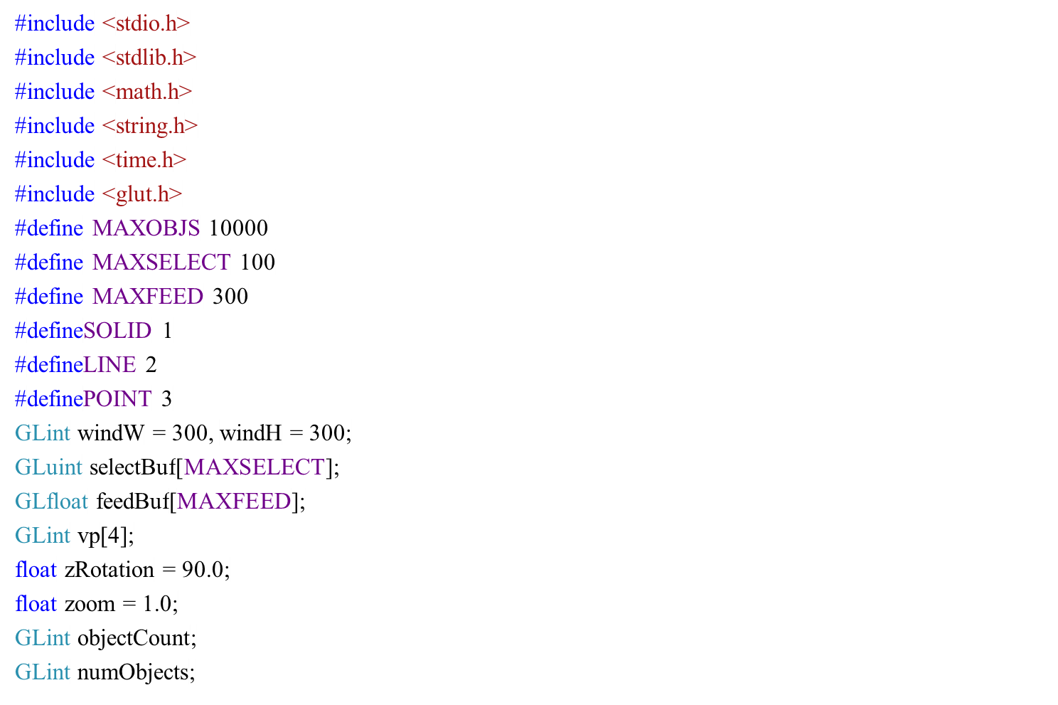
Seçme

Slide 31
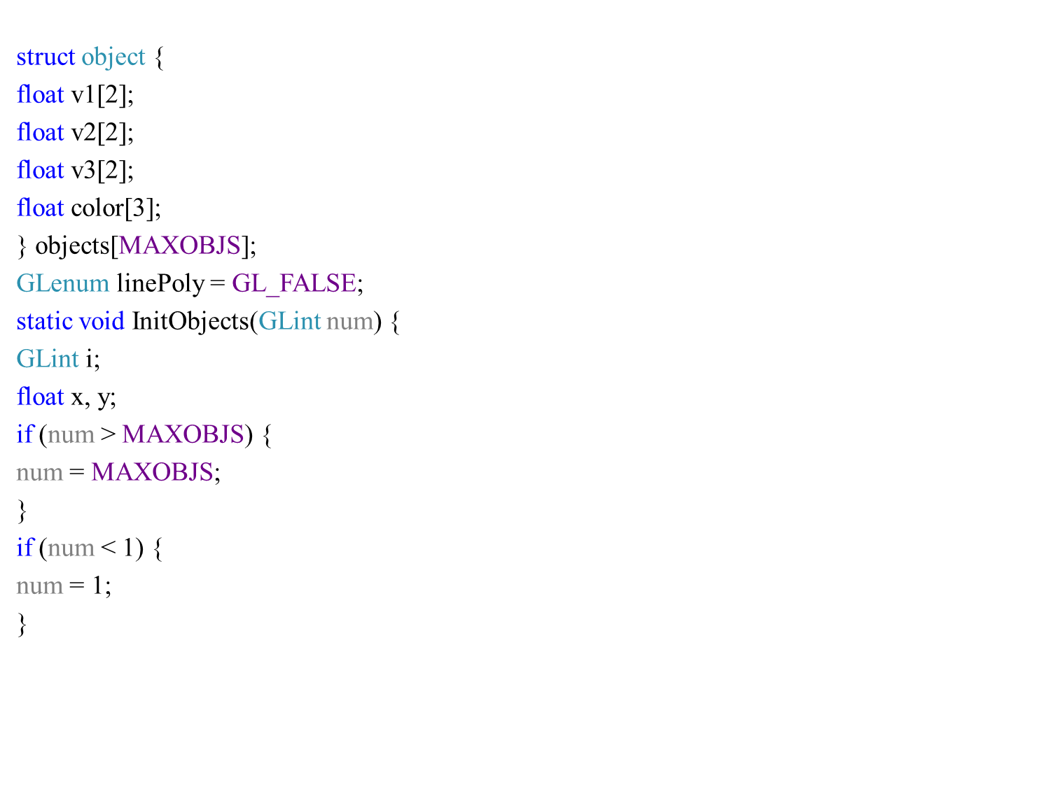

Slide 32
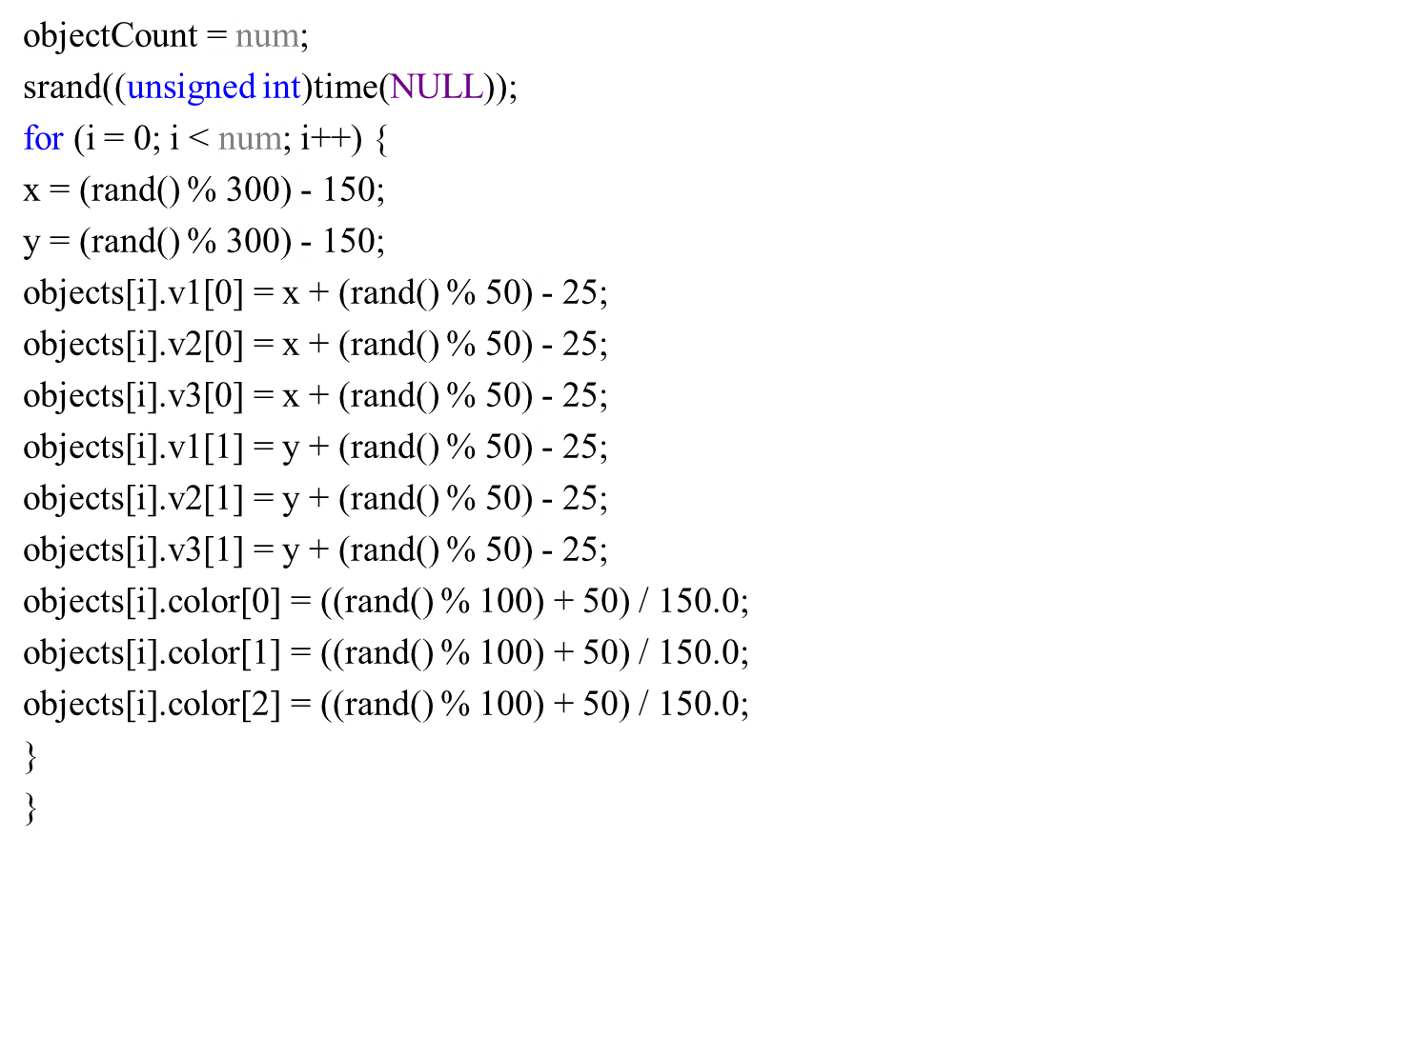

Slide 33
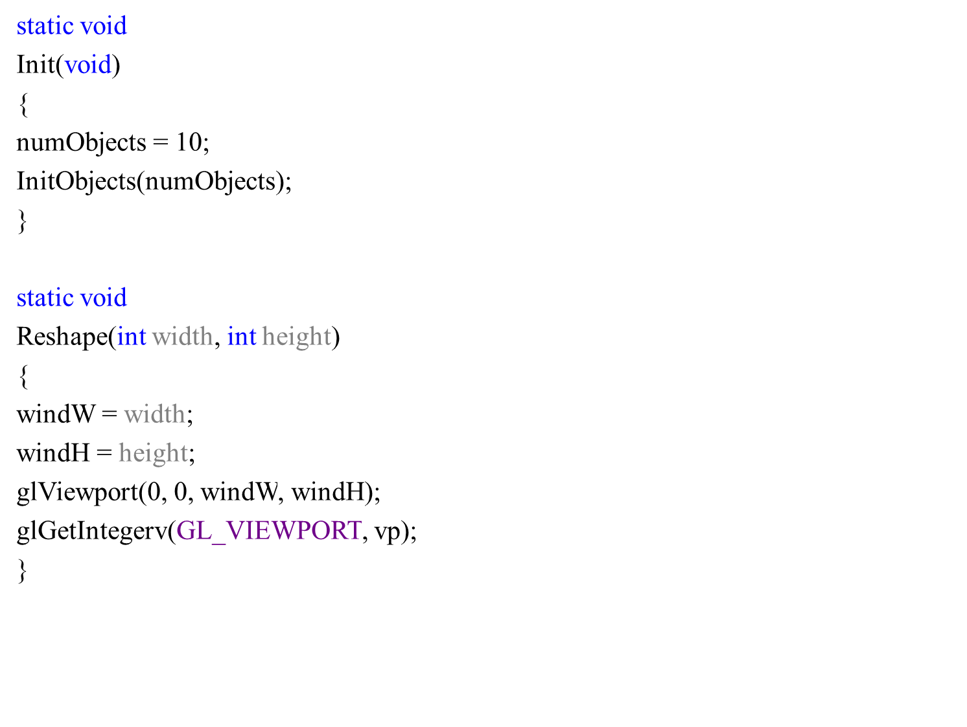

Slide 34
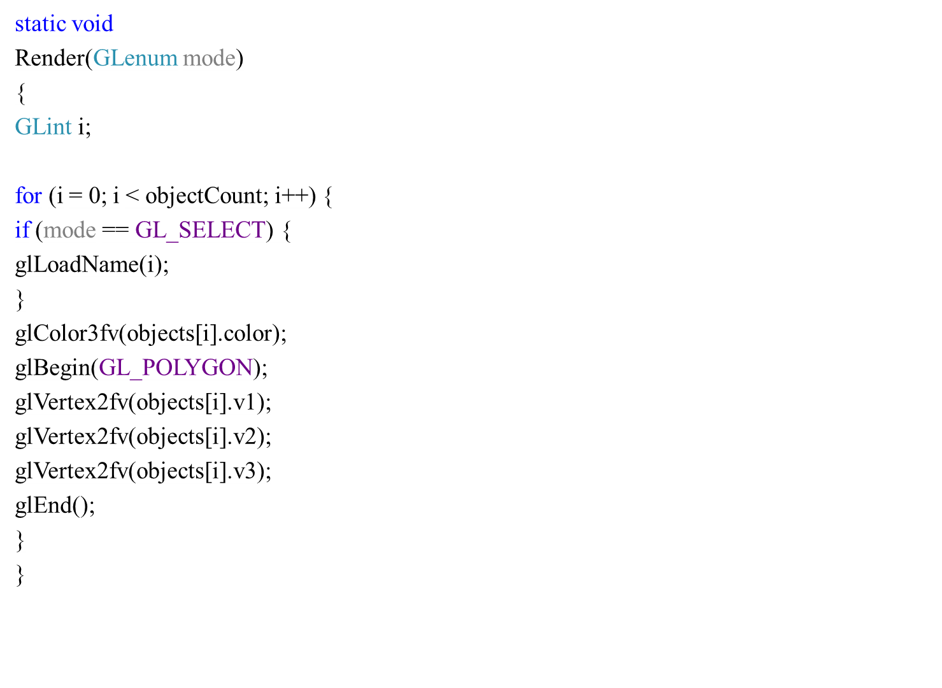

Slide 35
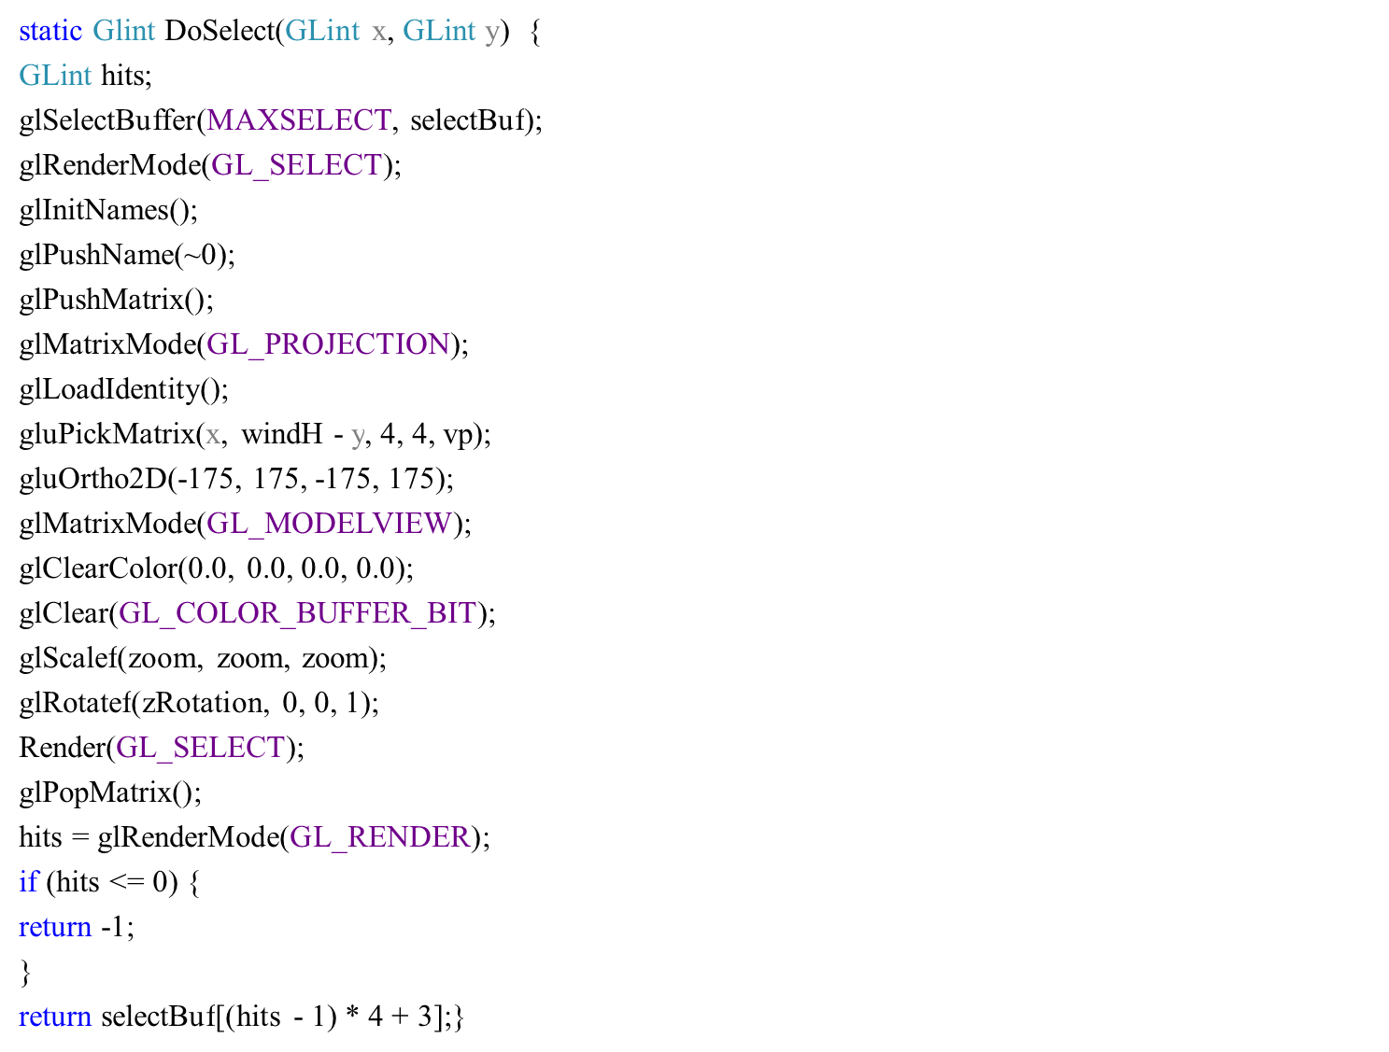

Slide 36
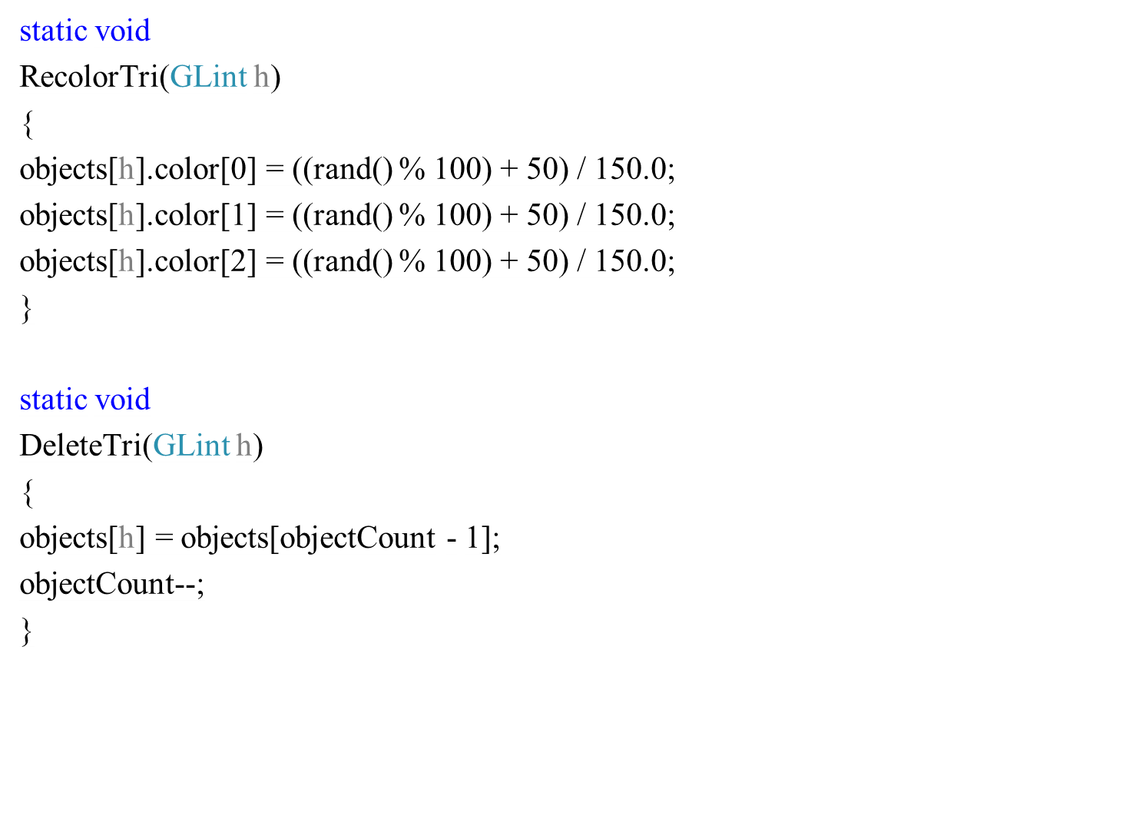

Slide 37
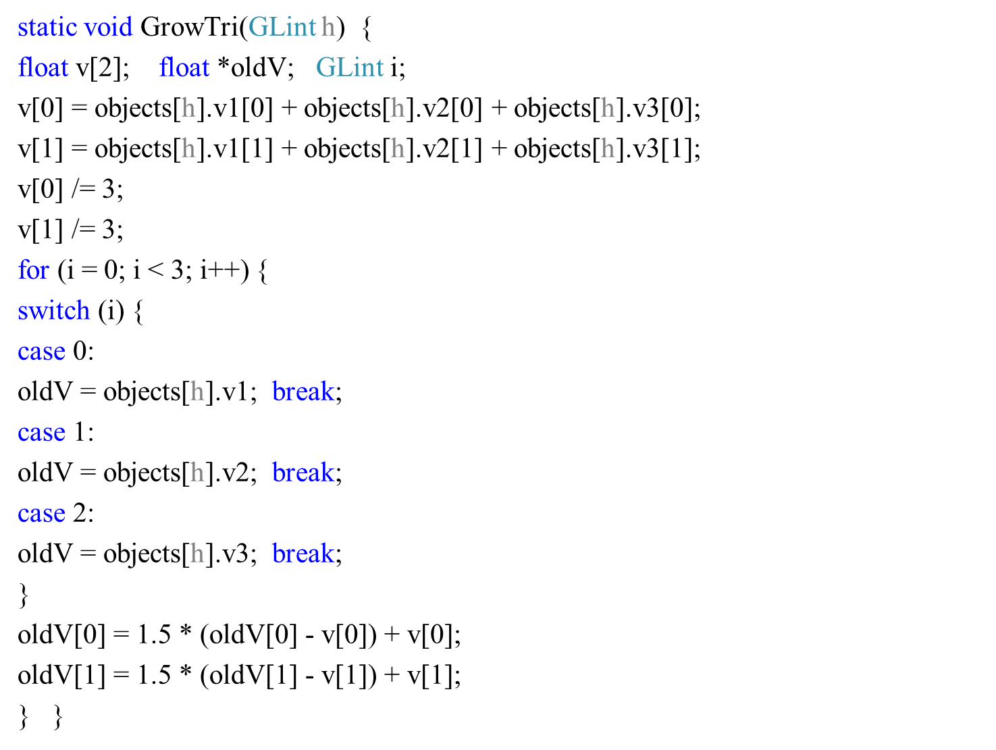

Slide 38
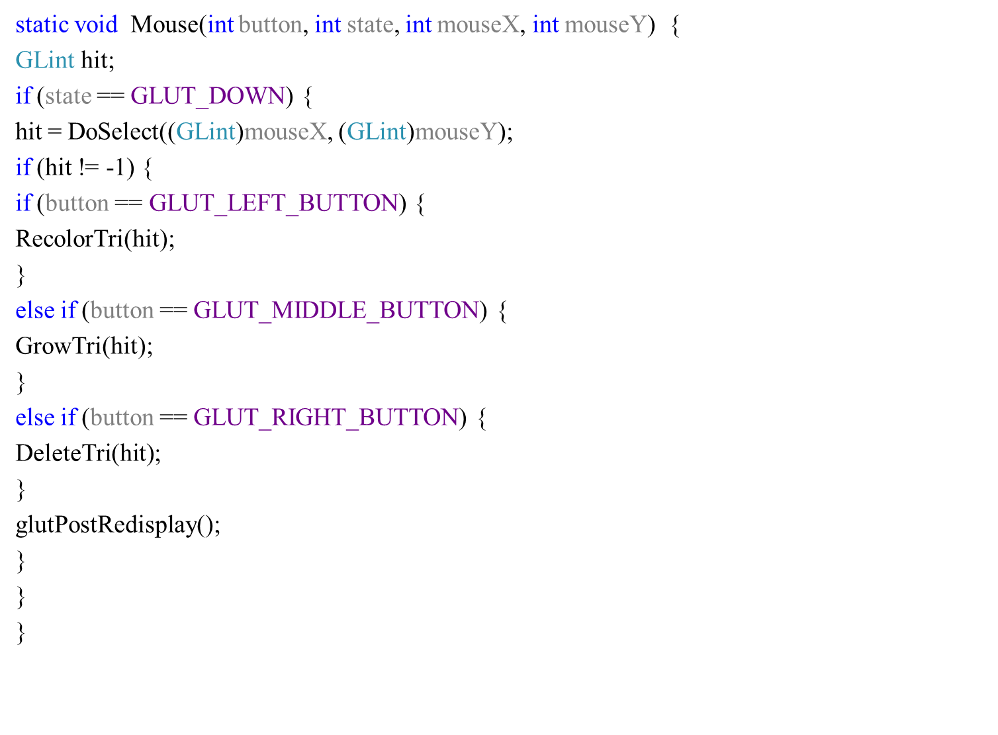

Slide 39
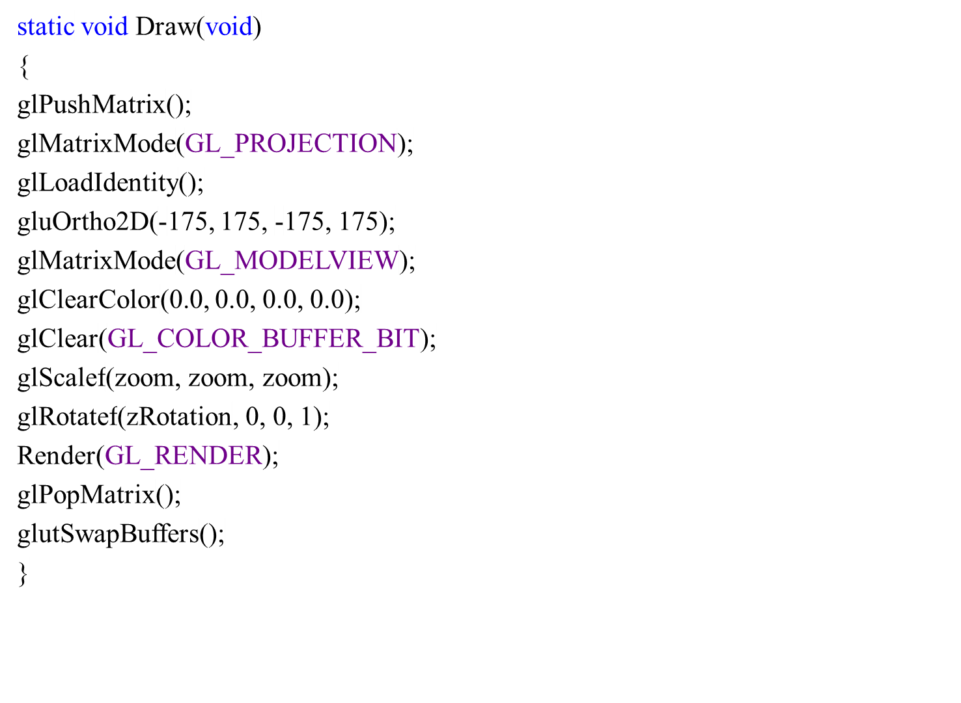

Slide 40
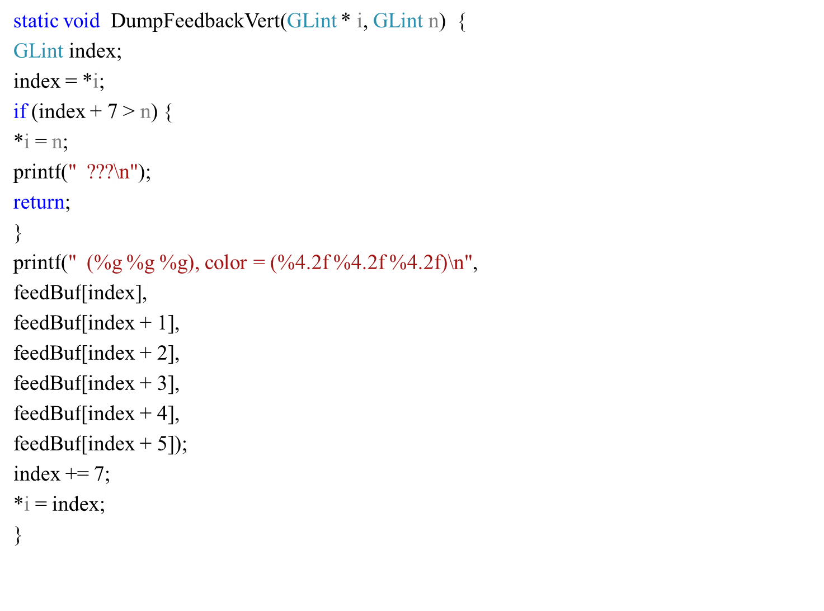

Slide 41
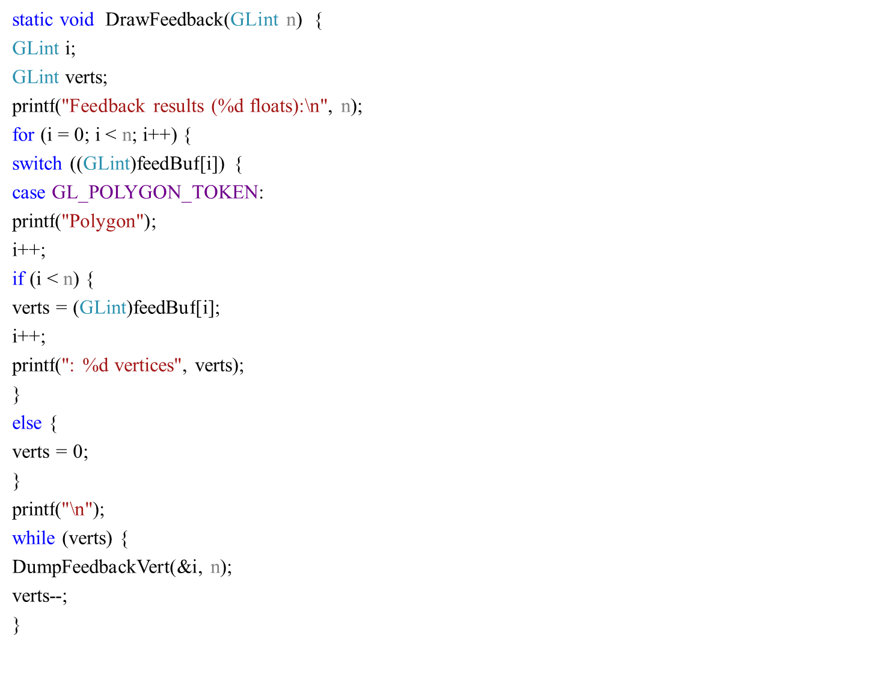

Slide 42
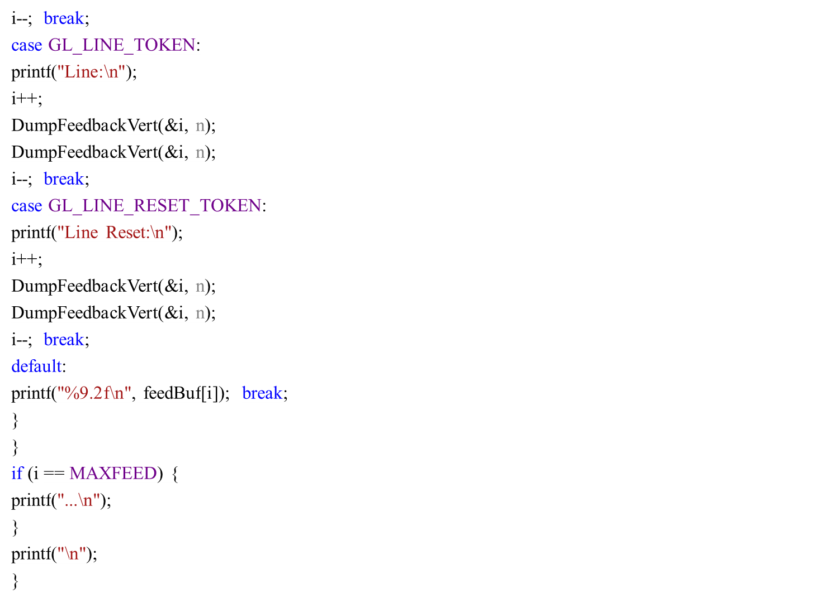

Slide 43
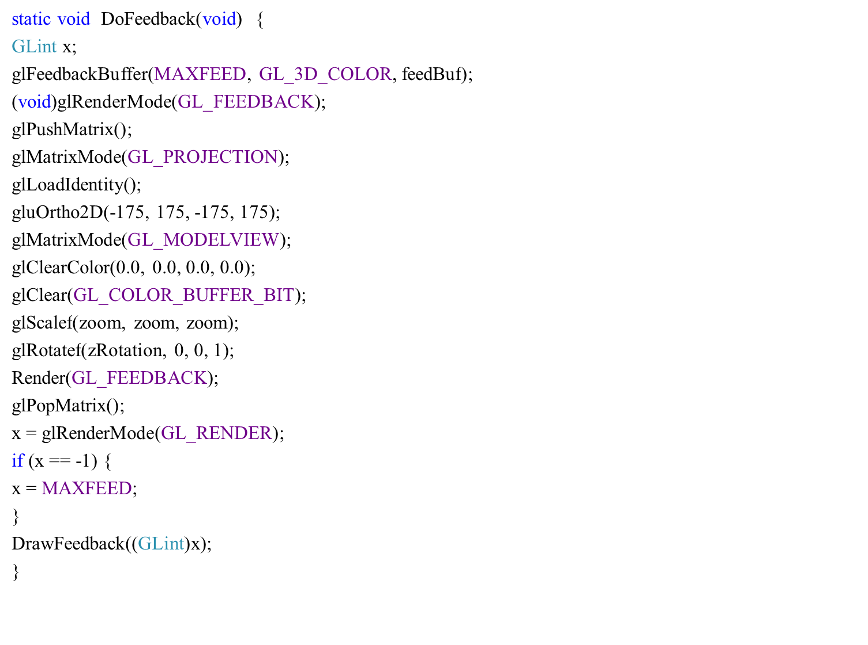

Slide 44
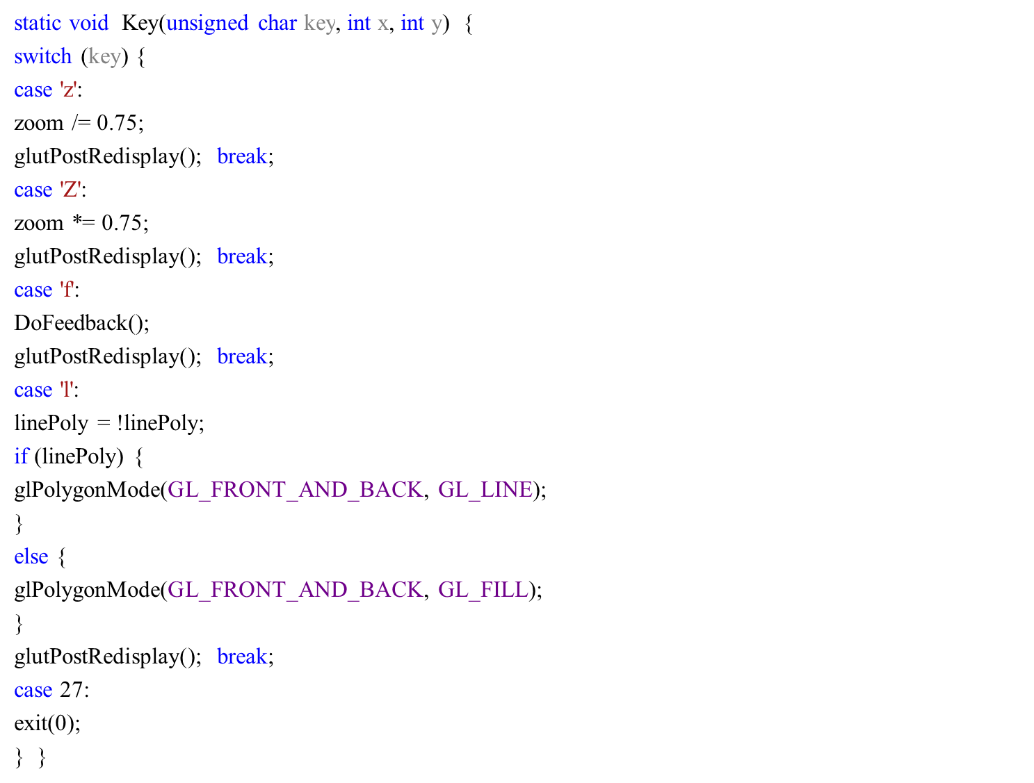

Slide 45
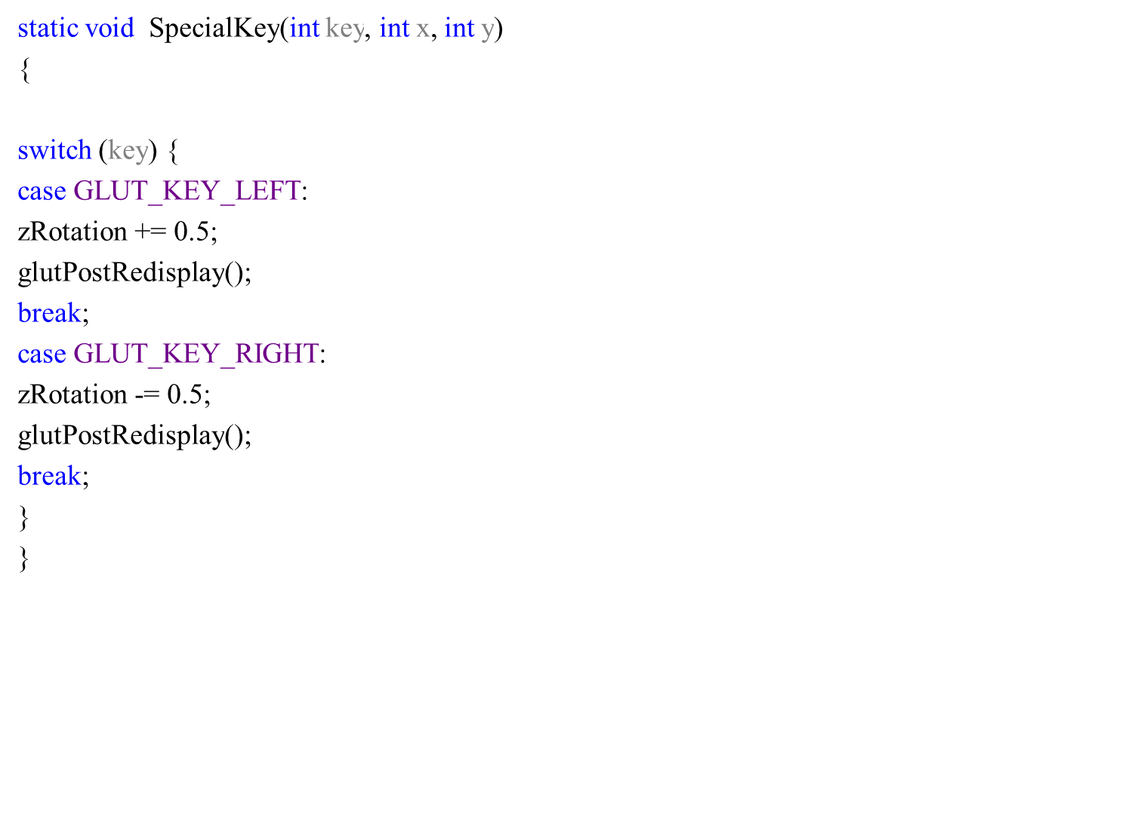

Slide 46
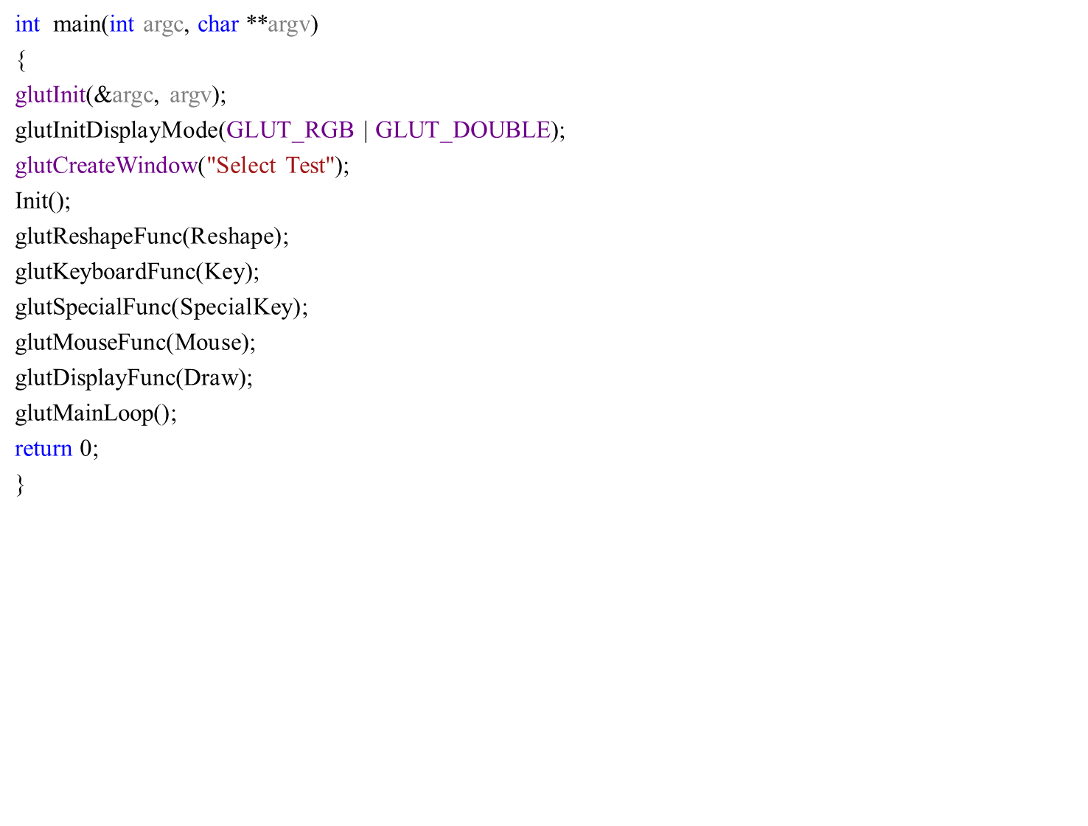

Slide 48
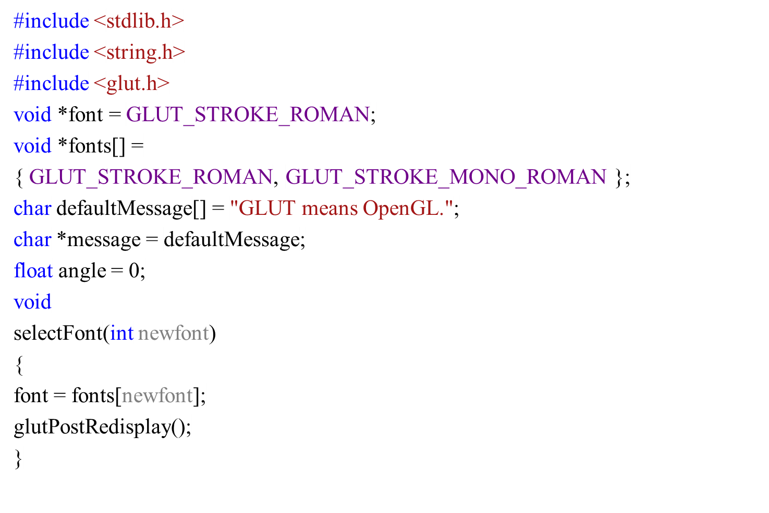
font

Slide 49
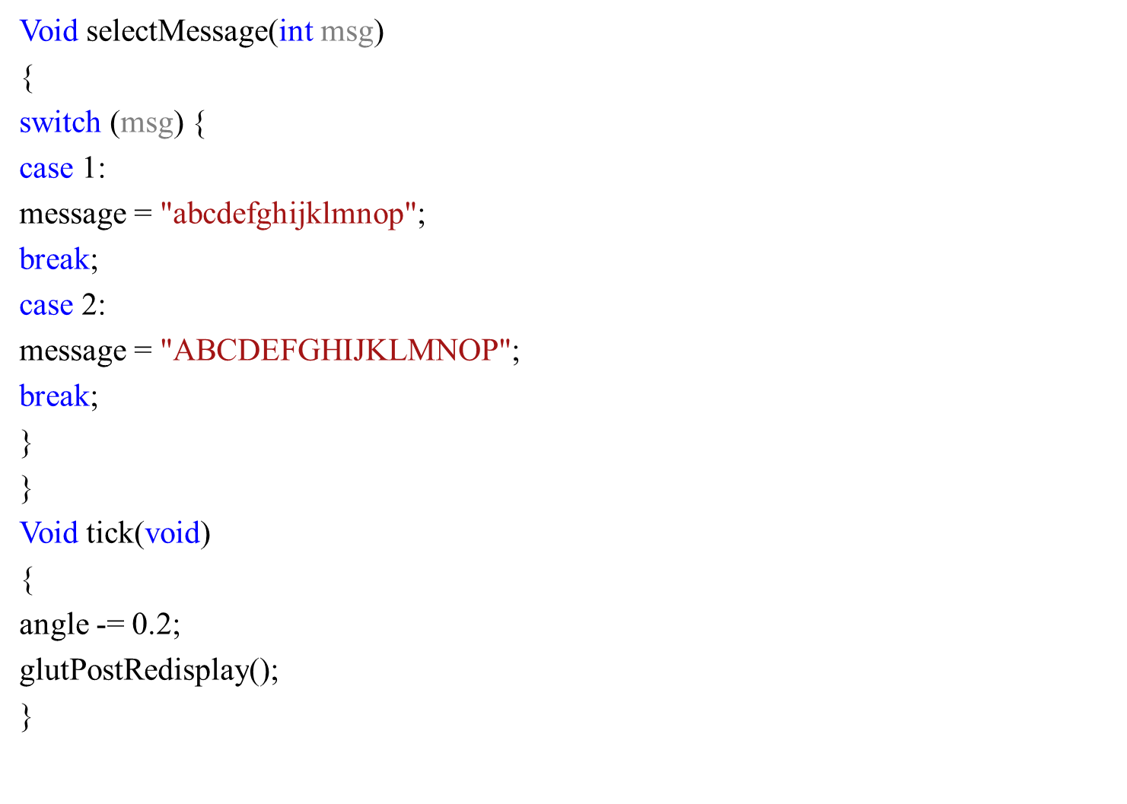

Slide 50
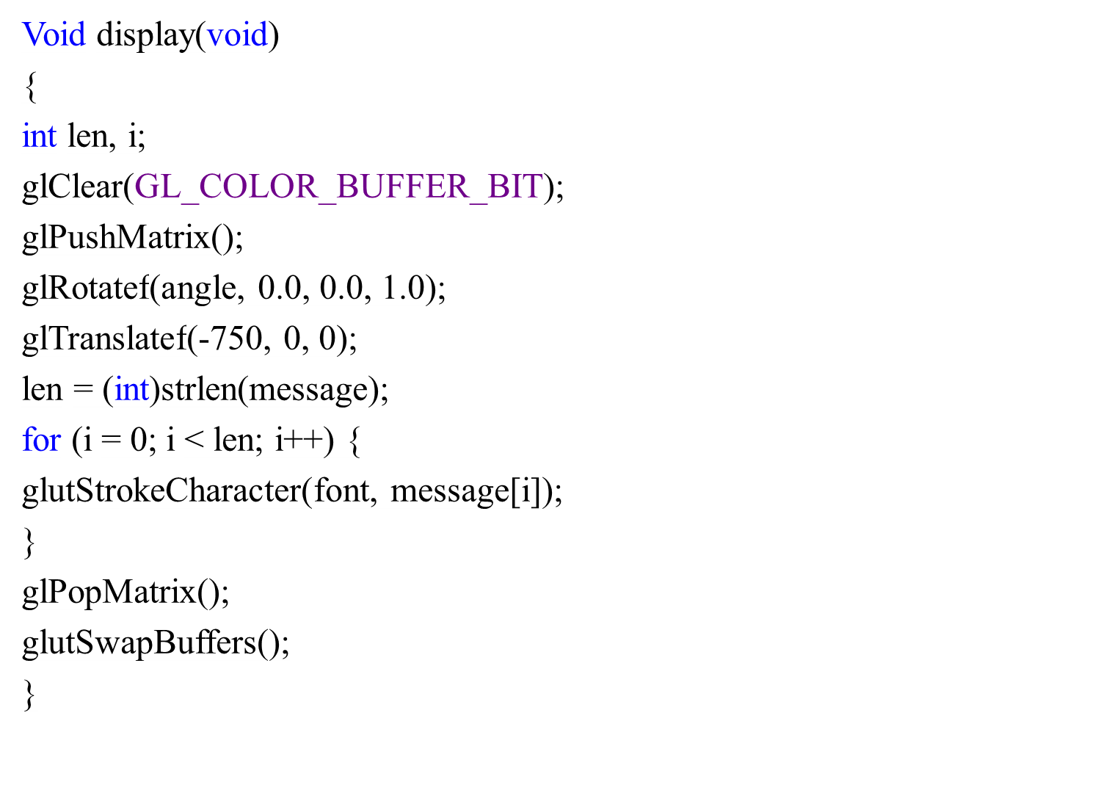

Slide 51
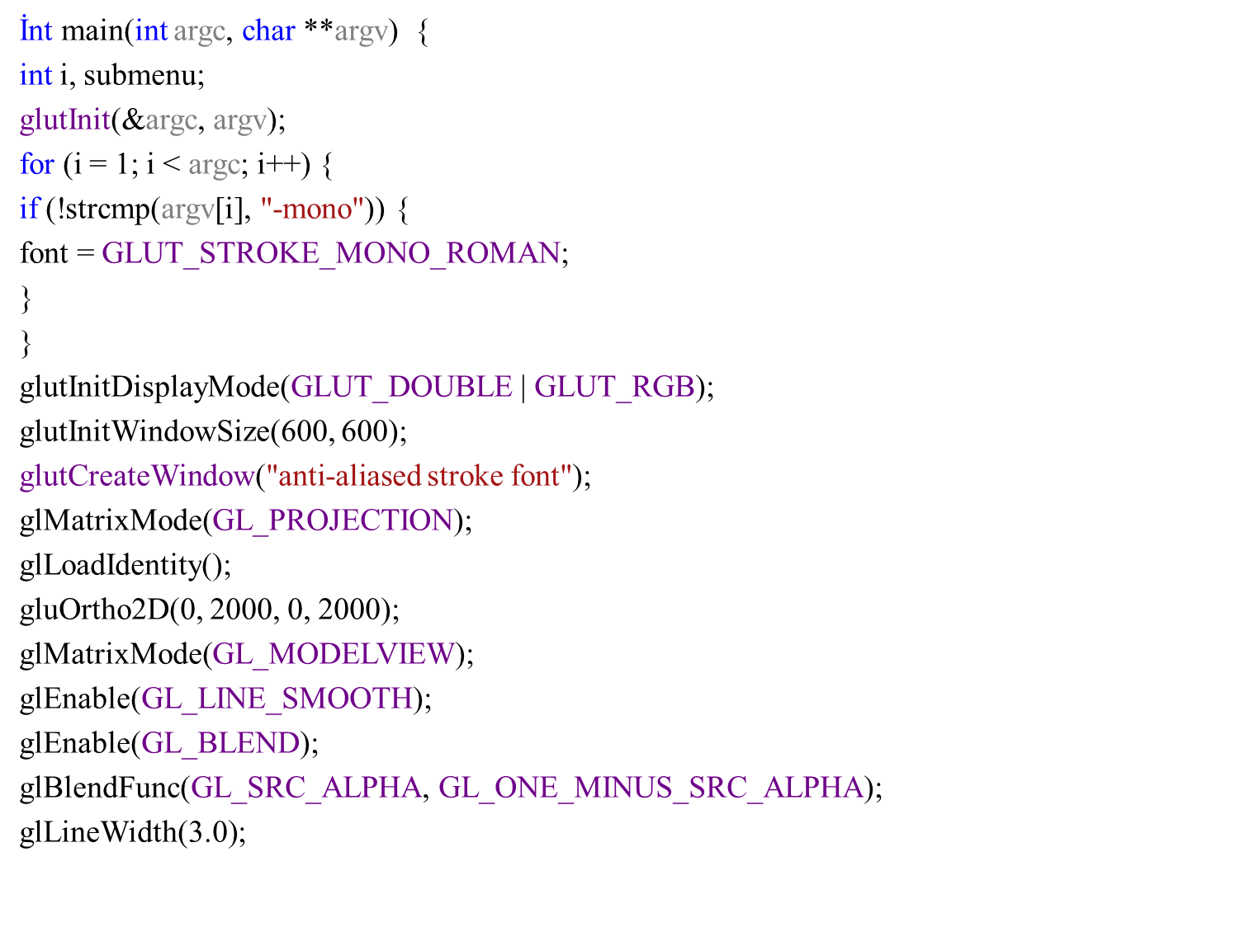

Slide 52
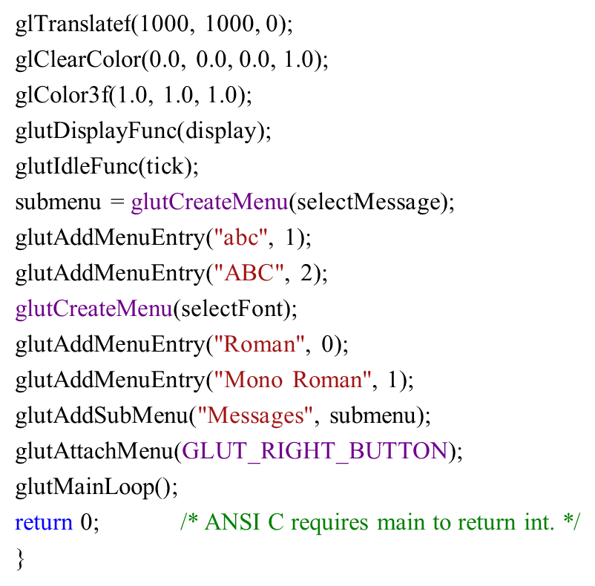

Slide 54
Animation using Idle Function
#include <stdio.h>
#include <stdlib.h>
#include <glut.h>
#include <math.h>
#include <windows.h>
// Global variable
GLfloat angle = 0.0f; // Current rotational angle of the shapes
/* Initialize OpenGL Graphics */
void initGL() {
// Set "clearing" or background color
glClearColor(0.0f, 0.0f, 0.0f, 1.0f); // Black and opaque
}
/* Called back when there is no other event to be handled */
void idle() {
glutPostRedisplay(); // Post a re-paint request to activate display()
}

Slide 55
void display() {
glClear(GL_COLOR_BUFFER_BIT); // Clear the color buffer
glMatrixMode(GL_MODELVIEW); // To operate on Model-View matrix
glLoadIdentity(); // Reset the model-view matrix
glPushMatrix(); // Save model-view matrix setting
glTranslatef(-0.5f, 0.4f, 0.0f); // Translate
glRotatef(angle, 0.0f, 0.0f, 1.0f); // rotate by angle in degrees
glBegin(GL_QUADS); // Each set of 4 vertices form a quad
glColor3f(1.0f, 0.0f, 0.0f); // Red
glVertex2f(-0.3f, -0.3f);
glVertex2f(0.3f, -0.3f);
glVertex2f(0.3f, 0.3f);
glVertex2f(-0.3f, 0.3f);
glEnd();
glPopMatrix(); // Restore the model-view matrix

Slide 56
glPushMatrix(); // Save model-view matrix setting
glTranslatef(-0.4f, -0.3f, 0.0f); // Translate
glRotatef(angle, 0.0f, 0.0f, 1.0f); // rotate by angle in degrees
glBegin(GL_QUADS);
glColor3f(0.0f, 1.0f, 0.0f); // Green
glVertex2f(-0.3f, -0.3f);
glVertex2f(0.3f, -0.3f);
glVertex2f(0.3f, 0.3f);
glVertex2f(-0.3f, 0.3f);
glEnd();
glPopMatrix(); // Restore the model-view matrix
glPushMatrix(); // Save model-view matrix setting
glTranslatef(-0.7f, -0.5f, 0.0f); // Translate
glRotatef(angle, 0.0f, 0.0f, 1.0f); // rotate by angle in degrees
glBegin(GL_QUADS);
glColor3f(0.2f, 0.2f, 0.2f); // Dark Gray
glVertex2f(-0.2f, -0.2f);
glColor3f(1.0f, 1.0f, 1.0f); // White
glVertex2f(0.2f, -0.2f);
glColor3f(0.2f, 0.2f, 0.2f); // Dark Gray
glVertex2f(0.2f, 0.2f);
glColor3f(1.0f, 1.0f, 1.0f); // White
glVertex2f(-0.2f, 0.2f);
glEnd();
glPopMatrix(); // Restore the model-view matrix

Slide 57
glPushMatrix(); // Save model-view matrix setting
glTranslatef(0.4f, -0.3f, 0.0f); // Translate
glRotatef(angle, 0.0f, 0.0f, 1.0f); // rotate by angle in degrees
glBegin(GL_TRIANGLES);
glColor3f(0.0f, 0.0f, 1.0f); // Blue
glVertex2f(-0.3f, -0.2f);
glVertex2f(0.3f, -0.2f);
glVertex2f(0.0f, 0.3f);
glEnd();
glPopMatrix(); // Restore the model-view matrix
glPushMatrix(); // Save model-view matrix setting
glTranslatef(0.6f, -0.6f, 0.0f); // Translate
glRotatef(180.0f + angle, 0.0f, 0.0f, 1.0f); // Rotate 180+angle degree
glBegin(GL_TRIANGLES);
glColor3f(1.0f, 0.0f, 0.0f); // Red
glVertex2f(-0.3f, -0.2f);
glColor3f(0.0f, 1.0f, 0.0f); // Green
glVertex2f(0.3f, -0.2f);
glColor3f(0.0f, 0.0f, 1.0f); // Blue
glVertex2f(0.0f, 0.3f);
glEnd();
glPopMatrix(); // Restore the model-view matrix

Slide 58
glPushMatrix(); // Save model-view matrix setting
glTranslatef(0.5f, 0.4f, 0.0f); // Translate
glRotatef(angle, 0.0f, 0.0f, 1.0f); // rotate by angle in degrees
glBegin(GL_POLYGON);
glColor3f(1.0f, 1.0f, 0.0f); // Yellow
glVertex2f(-0.1f, -0.2f);
glVertex2f(0.1f, -0.2f);
glVertex2f(0.2f, 0.0f);
glVertex2f(0.1f, 0.2f);
glVertex2f(-0.1f, 0.2f);
glVertex2f(-0.2f, 0.0f);
glEnd();
glPopMatrix(); // Restore the model-view matrix
glutSwapBuffers(); // Double buffered - swap the front and back buffers
// Change the rotational angle after each display()
angle += 0.2f;
}

Slide 59
void reshape(GLsizei width, GLsizei height) { // GLsizei for non-negative integer
// Compute aspect ratio of the new window
if (height == 0) height = 1; // To prevent divide by 0
GLfloat aspect = (GLfloat)width / (GLfloat)height;
// Set the viewport to cover the new window
glViewport(0, 0, width, height);
// Set the aspect ratio of the clipping area to match the viewport
glMatrixMode(GL_PROJECTION); // To operate on the Projection matrix
glLoadIdentity();
if (width >= height) {
// aspect >= 1, set the height from -1 to 1, with larger width
gluOrtho2D(-1.0 * aspect, 1.0 * aspect, -1.0, 1.0);
}
else {
// aspect < 1, set the width to -1 to 1, with larger height
gluOrtho2D(-1.0, 1.0, -1.0 / aspect, 1.0 / aspect);
}
}

Slide 60
int main(int argc, char** argv) {
glutInit(&argc, argv); // Initialize GLUT
glutInitDisplayMode(GLUT_DOUBLE); // Enable double buffered mode
glutInitWindowSize(640, 480); // Set the window's initial width & height - non-square
glutInitWindowPosition(50, 50); // Position the window's initial top-left corner
glutCreateWindow("Animation via Idle Function"); // Create window with the given title
glutDisplayFunc(display); // Register callback handler for window re-paint event
glutReshapeFunc(reshape); // Register callback handler for window re-size event
glutIdleFunc(idle); // Register callback handler if no other event
initGL(); // Our own OpenGL initialization
glutMainLoop(); // Enter the infinite event-processing loop
return 0;
}

Slide 62
Animation via Timer Function
#include <stdio.h>
#include <stdlib.h>
#include <glut.h>
#include <math.h>
#include <windows.h>
GLfloat angle = 0.0f; // rotational angle of the shapes
int refreshMills = 30; // refresh interval in milliseconds
/* Initialize OpenGL Graphics */
void initGL() {
// Set "clearing" or background color
glClearColor(0.0f, 0.0f, 0.0f, 1.0f); // Black and opaque
}
/* Called back when timer expired */
void Timer(int value) {
glutPostRedisplay(); // Post re-paint request to activate display()
glutTimerFunc(refreshMills, Timer, 0); // next Timer call milliseconds later
}

Slide 63
void display() {
glClear(GL_COLOR_BUFFER_BIT); // Clear the color buffer
glMatrixMode(GL_MODELVIEW); // To operate on Model-View matrix
glLoadIdentity(); // Reset the model-view matrix
glPushMatrix(); // Save model-view matrix setting
glTranslatef(-0.5f, 0.4f, 0.0f); // Translate
glRotatef(angle, 0.0f, 0.0f, 1.0f); // rotate by angle in degrees
glBegin(GL_QUADS); // Each set of 4 vertices form a quad
glColor3f(1.0f, 0.0f, 0.0f); // Red
glVertex2f(-0.3f, -0.3f);
glVertex2f(0.3f, -0.3f);
glVertex2f(0.3f, 0.3f);
glVertex2f(-0.3f, 0.3f);
glEnd();
glPopMatrix(); // Restore the model-view matrix
glPushMatrix(); // Save model-view matrix setting
glTranslatef(-0.4f, -0.3f, 0.0f); // Translate
glRotatef(angle, 0.0f, 0.0f, 1.0f); // rotate by angle in degrees
glBegin(GL_QUADS);
glColor3f(0.0f, 1.0f, 0.0f); // Green
glVertex2f(-0.3f, -0.3f);
glVertex2f(0.3f, -0.3f);
glVertex2f(0.3f, 0.3f);
glVertex2f(-0.3f, 0.3f);
glEnd();
glPopMatrix(); // Restore the model-view matrix
glPushMatrix(); // Save model-view matrix setting
glTranslatef(-0.7f, -0.5f, 0.0f); // Translate
glRotatef(angle, 0.0f, 0.0f, 1.0f); // rotate by angle in degrees
glBegin(GL_QUADS);
glColor3f(0.2f, 0.2f, 0.2f); // Dark Gray
glVertex2f(-0.2f, -0.2f);
glColor3f(1.0f, 1.0f, 1.0f); // White
glVertex2f(0.2f, -0.2f);
glColor3f(0.2f, 0.2f, 0.2f); // Dark Gray
glVertex2f(0.2f, 0.2f);
glColor3f(1.0f, 1.0f, 1.0f); // White
glVertex2f(-0.2f, 0.2f);
glEnd();
glPopMatrix(); // Restore the model-view matrix

Slide 64
glPushMatrix(); // Save model-view matrix setting
glTranslatef(0.4f, -0.3f, 0.0f); // Translate
glRotatef(angle, 0.0f, 0.0f, 1.0f); // rotate by angle in degrees
glBegin(GL_TRIANGLES);
glColor3f(0.0f, 0.0f, 1.0f); // Blue
glVertex2f(-0.3f, -0.2f);
glVertex2f(0.3f, -0.2f);
glVertex2f(0.0f, 0.3f);
glEnd();
glPopMatrix(); // Restore the model-view matrix
glPushMatrix(); // Save model-view matrix setting
glTranslatef(0.6f, -0.6f, 0.0f); // Translate
glRotatef(180.0f + angle, 0.0f, 0.0f, 1.0f); // Rotate 180+angle degree
glBegin(GL_TRIANGLES);
glColor3f(1.0f, 0.0f, 0.0f); // Red
glVertex2f(-0.3f, -0.2f);
glColor3f(0.0f, 1.0f, 0.0f); // Green
glVertex2f(0.3f, -0.2f);
glColor3f(0.0f, 0.0f, 1.0f); // Blue
glVertex2f(0.0f, 0.3f);
glEnd();
glPopMatrix(); // Restore the model-view matrix
glPushMatrix(); // Save model-view matrix setting
glTranslatef(0.5f, 0.4f, 0.0f); // Translate
glRotatef(angle, 0.0f, 0.0f, 1.0f); // rotate by angle in degrees
glBegin(GL_POLYGON);
glColor3f(1.0f, 1.0f, 0.0f); // Yellow
glVertex2f(-0.1f, -0.2f);
glVertex2f(0.1f, -0.2f);
glVertex2f(0.2f, 0.0f);
glVertex2f(0.1f, 0.2f);
glVertex2f(-0.1f, 0.2f);
glVertex2f(-0.2f, 0.0f);
glEnd();
glPopMatrix(); // Restore the model-view matrix
glutSwapBuffers(); // Double buffered - swap the front and back buffers
angle += 2.0f;
}

Slide 65
void reshape(GLsizei width, GLsizei height) { // GLsizei for non-negative integer
if (height == 0) height = 1; // To prevent divide by 0
GLfloat aspect = (GLfloat)width / (GLfloat)height;
glViewport(0, 0, width, height);
glMatrixMode(GL_PROJECTION); // To operate on the Projection matrix
glLoadIdentity();
if (width >= height) {
// aspect >= 1, set the height from -1 to 1, with larger width
gluOrtho2D(-1.0 * aspect, 1.0 * aspect, -1.0, 1.0);
}
else {
// aspect < 1, set the width to -1 to 1, with larger height
gluOrtho2D(-1.0, 1.0, -1.0 / aspect, 1.0 / aspect);
}
}
int main(int argc, char** argv) {
glutInit(&argc, argv); // Initialize GLUT
glutInitDisplayMode(GLUT_DOUBLE); // Enable double buffered mode
glutInitWindowSize(640, 480); // Set the window's initial width & height - non-square
glutInitWindowPosition(50, 50); // Position the window's initial top-left corner
glutCreateWindow("Animation via Idle Function"); // Create window with the given title
glutDisplayFunc(display); // Register callback handler for window re-paint event
glutReshapeFunc(reshape); // Register callback handler for window re-size event
glutTimerFunc(1000, Timer, 0); // First timer call immediately
initGL(); // Our own OpenGL initialization
glutMainLoop(); // Enter the infinite event-processing loop
return 0;
}

Slide 67
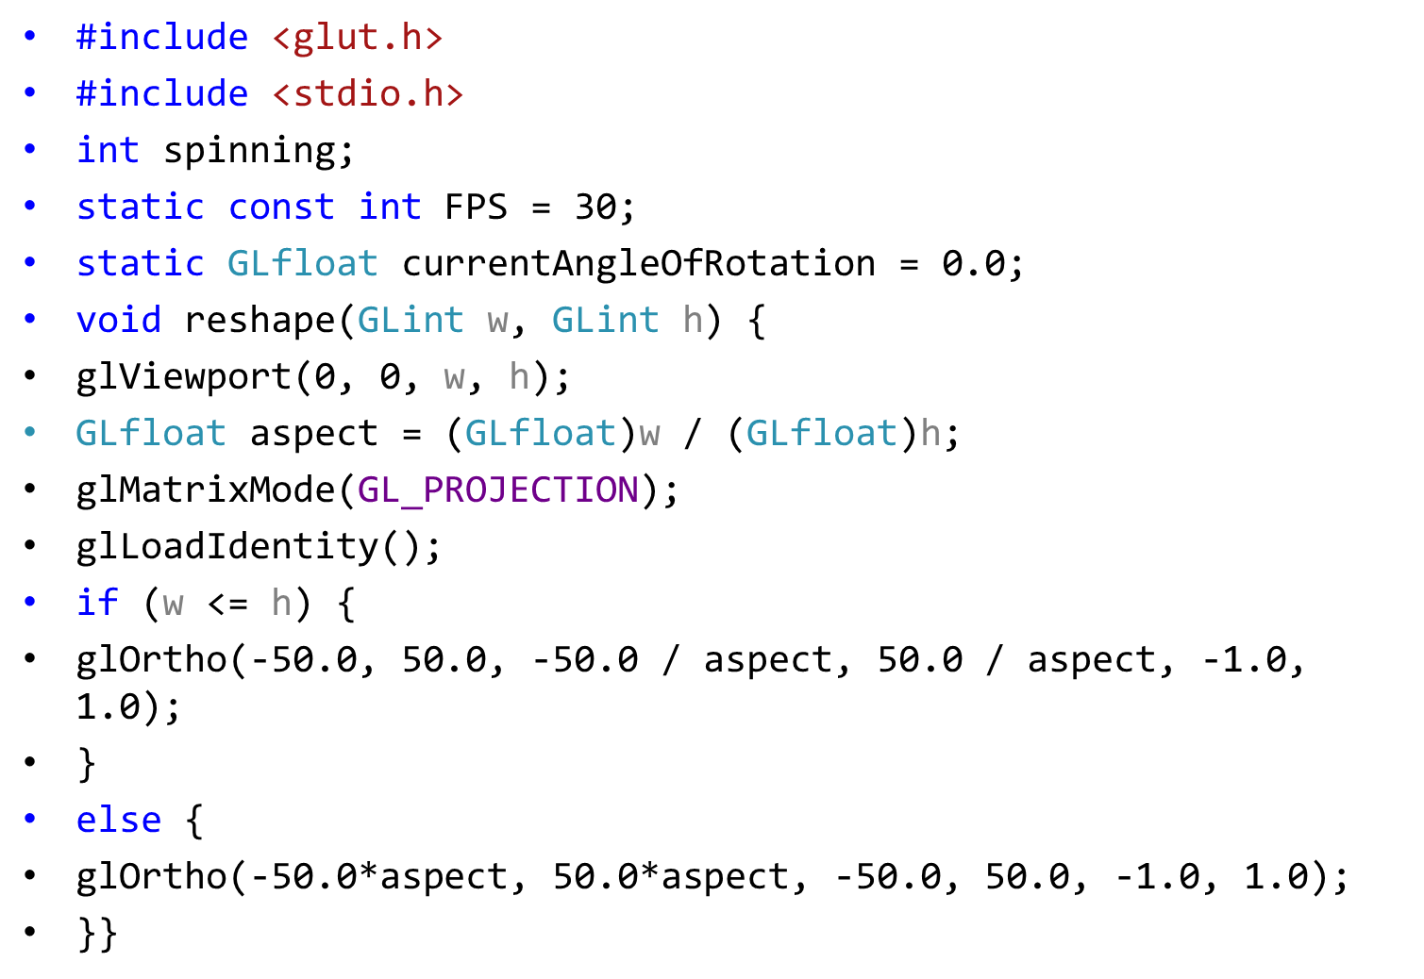
With timer:

Slide 68
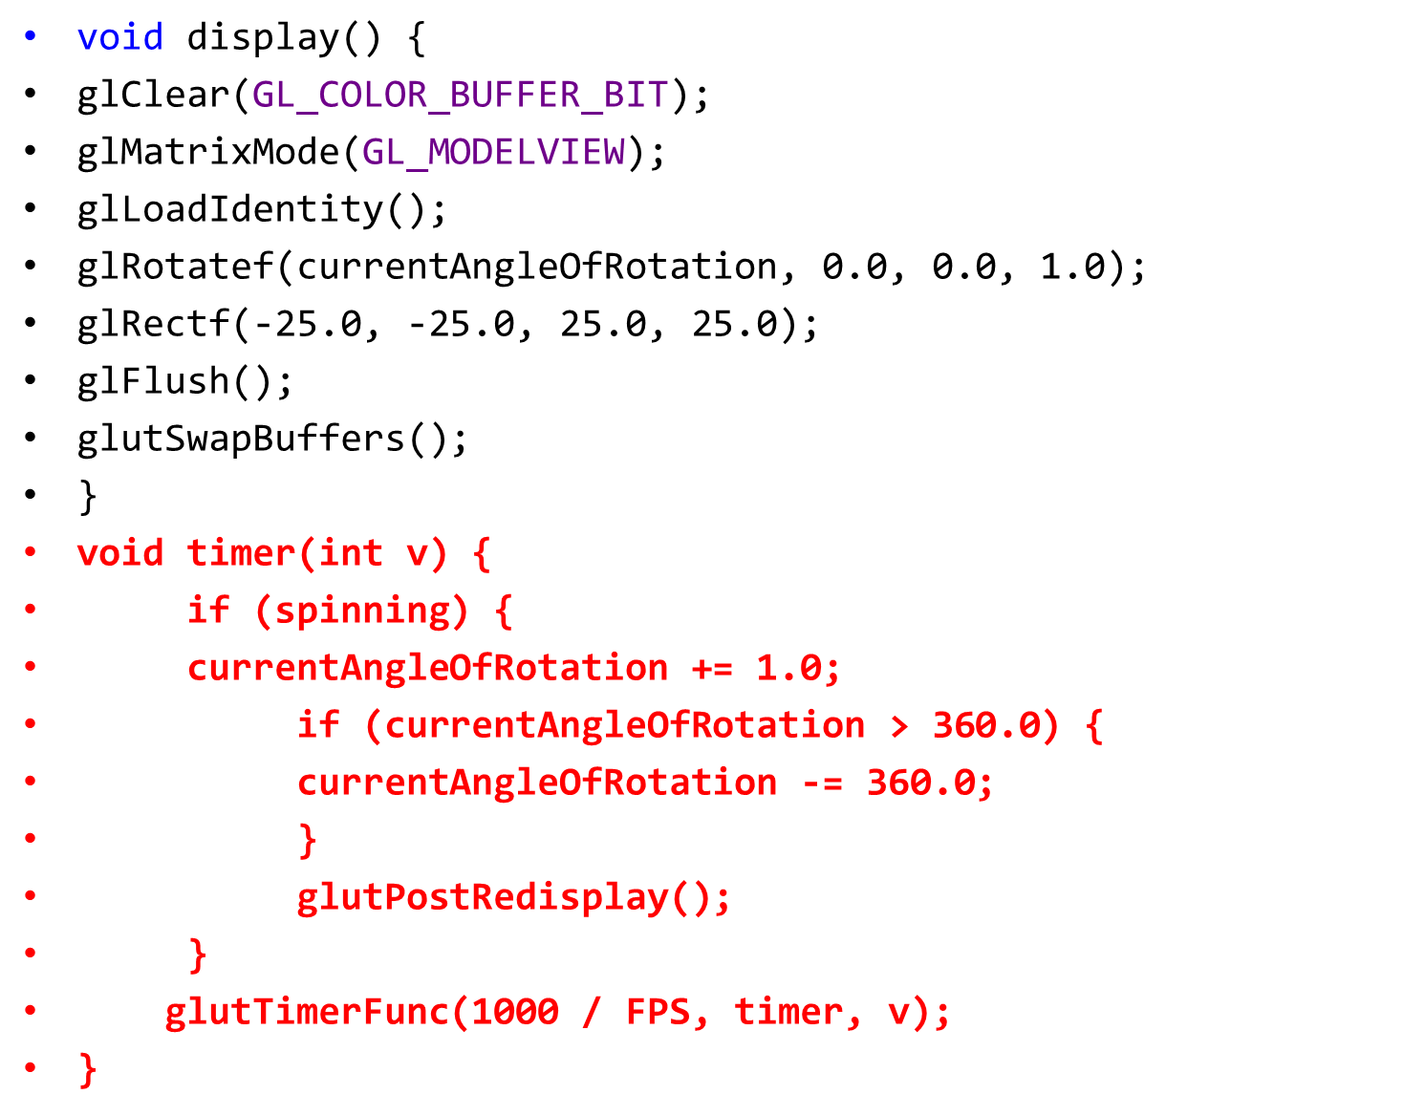

Slide 69
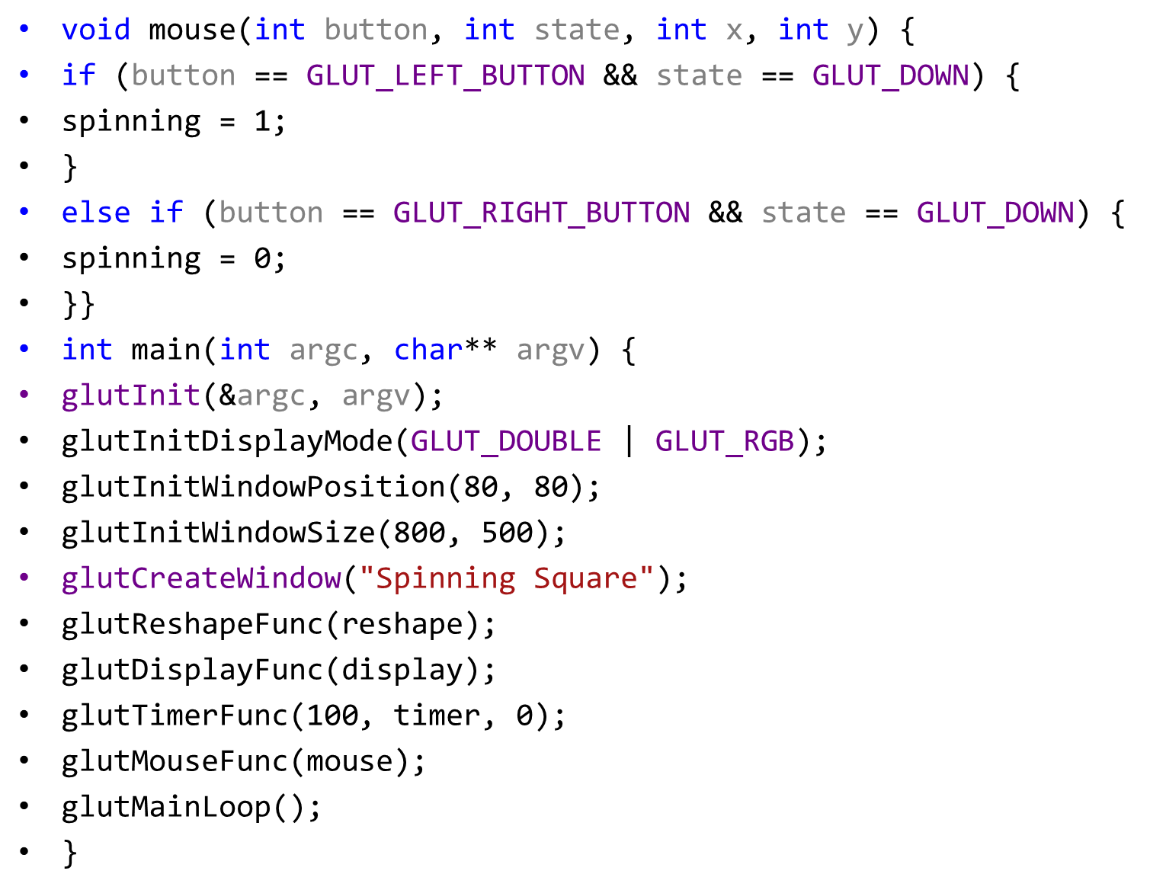

Slide 71
A Bouncing Ball
#include <stdio.h>
#include <stdlib.h>
#include <glut.h>
#include <math.h>
#include <windows.h>
#define PI 3.14159265f
char title[] = "Bouncing Ball (2D)"; // Windowed mode's title
int windowWidth = 640; // Windowed mode's width
int windowHeight = 480; // Windowed mode's height
int windowPosX = 50; // Windowed mode's top-left corner x
int windowPosY = 50; // Windowed mode's top-left corner y
GLfloat ballRadius = 0.5f; // Radius of the bouncing ball
GLfloat ballX = 0.0f; // Ball's center (x, y) position
GLfloat ballY = 0.0f;
GLfloat ballXMax, ballXMin, ballYMax, ballYMin; // Ball's center (x, y) bounds
GLfloat xSpeed = 0.02f; // Ball's speed in x and y directions
GLfloat ySpeed = 0.007f;
int refreshMillis = 30; // Refresh period in milliseconds
// Projection clipping area
GLdouble clipAreaXLeft, clipAreaXRight, clipAreaYBottom, clipAreaYTop;

Slide 72
void initGL() {
glClearColor(0.0, 0.0, 0.0, 1.0); // Set background (clear) color to black
}
/* Callback handler for window re-paint event */
void display() {
glClear(GL_COLOR_BUFFER_BIT); // Clear the color buffer
glMatrixMode(GL_MODELVIEW); // To operate on the model-view matrix
glLoadIdentity(); // Reset model-view matrix
glTranslatef(ballX, ballY, 0.0f); // Translate to (xPos, yPos)
// Use triangular segments to form a circle
glBegin(GL_TRIANGLE_FAN);
glColor3f(0.0f, 0.0f, 1.0f); // Blue
glVertex2f(0.0f, 0.0f); // Center of circle
int numSegments = 100;
GLfloat angle;

Slide 73
for (int i = 0; i <= numSegments; i++) { // Last vertex same as first vertex
angle = i * 2.0f * PI / numSegments; // 360 deg for all segments
glVertex2f(cos(angle) * ballRadius, sin(angle) * ballRadius);
}
glEnd();
glutSwapBuffers(); // Swap front and back buffers (of double buffered mode)
ballX += xSpeed; // Animation Control - compute the location for the next refresh
ballY += ySpeed;
if (ballX > ballXMax) {// Check if the ball exceeds the edges
ballX = ballXMax;
xSpeed = -xSpeed;
}
else if (ballX < ballXMin) {
ballX = ballXMin;
xSpeed = -xSpeed;
}
if (ballY > ballYMax) {
ballY = ballYMax;
ySpeed = -ySpeed;
}
else if (ballY < ballYMin) {
ballY = ballYMin;
ySpeed = -ySpeed;
} }

Slide 74
void reshape(GLsizei width, GLsizei height) {
if (height == 0) height = 1; // Compute aspect ratio of the new window,To prevent divide by 0
GLfloat aspect = (GLfloat)width / (GLfloat)height;
glViewport(0, 0, width, height);
// Set the aspect ratio of the clipping area to match the viewport
glMatrixMode(GL_PROJECTION); // To operate on the Projection matrix
glLoadIdentity(); // Reset the projection matrix
if (width >= height) {
clipAreaXLeft = -1.0 * aspect;
clipAreaXRight = 1.0 * aspect;
clipAreaYBottom = -1.0;
clipAreaYTop = 1.0;
}

Slide 75
else {
clipAreaXLeft = -1.0;
clipAreaXRight = 1.0;
clipAreaYBottom = -1.0 / aspect;
clipAreaYTop = 1.0 / aspect;
}
gluOrtho2D(clipAreaXLeft, clipAreaXRight, clipAreaYBottom, clipAreaYTop);
ballXMin = clipAreaXLeft + ballRadius;
ballXMax = clipAreaXRight - ballRadius;
ballYMin = clipAreaYBottom + ballRadius;
ballYMax = clipAreaYTop - ballRadius;
}

Slide 76
void Timer(int value) {
glutPostRedisplay(); // Post a paint request to activate display()
glutTimerFunc(refreshMillis, Timer, 0); // subsequent timer call at milliseconds
}
int main(int argc, char** argv) {
glutInit(&argc, argv); // Initialize GLUT
glutInitDisplayMode(GLUT_DOUBLE); // Enable double buffered mode
glutInitWindowSize(windowWidth, windowHeight); // Initial window width and height
glutInitWindowPosition(windowPosX, windowPosY); // Initial window top-left corner (x, y)
glutCreateWindow(title); // Create window with given title
glutDisplayFunc(display); // Register callback handler for window re-paint
glutReshapeFunc(reshape); // Register callback handler for window re-shape
glutTimerFunc(0, Timer, 0); // First timer call immediately
initGL(); // Our own OpenGL initialization
glutMainLoop(); // Enter event-processing loop
return 0;
}

Slide 78
Full screen
#include <stdio.h>
#include <stdlib.h>
#include <glut.h>
#include <math.h>
#include <windows.h>
#define PI 3.14159265f
char title[] = "Full-Screen & Windowed Mode"; // Windowed mode's title
int windowWidth = 640; // Windowed mode's width
int windowHeight = 480; // Windowed mode's height
int windowPosX = 50; // Windowed mode's top-left corner x
int windowPosY = 50; // Windowed mode's top-left corner y
GLfloat ballRadius = 0.5f; // Radius of the bouncing ball
GLfloat ballX = 0.0f; // Ball's center (x, y) position
GLfloat ballY = 0.0f;
GLfloat ballXMax, ballXMin, ballYMax, ballYMin; // Ball's center (x, y) bounds
GLfloat xSpeed = 0.02f; // Ball's speed in x and y directions
GLfloat ySpeed = 0.007f;
int refreshMillis = 30; // Refresh period in milliseconds
// Projection clipping area
GLdouble clipAreaXLeft, clipAreaXRight, clipAreaYBottom, clipAreaYTop;
int fullScreenMode = 1; // Full-screen or windowed mode?

Slide 79
void initGL() {
glClearColor(0.0, 0.0, 0.0, 1.0); // Set background (clear) color to black
}
void display() {
glClear(GL_COLOR_BUFFER_BIT); // Clear the color buffer
glMatrixMode(GL_MODELVIEW); // To operate on the model-view matrix
glLoadIdentity(); // Reset model-view matrix
glTranslatef(ballX, ballY, 0.0f); // Translate to (xPos, yPos)
// Use triangular segments to form a circle
glBegin(GL_TRIANGLE_FAN);
glColor3f(0.0f, 0.0f, 1.0f); // Blue
glVertex2f(0.0f, 0.0f); // Center of circle
int numSegments = 100;
GLfloat angle;
for (int i = 0; i <= numSegments; i++) { // Last vertex same as first vertex
angle = i * 2.0f * PI / numSegments; // 360 deg for all segments
glVertex2f(cos(angle) * ballRadius, sin(angle) * ballRadius);
}
glEnd();

Slide 80
glutSwapBuffers(); // Swap front and back buffers (of double buffered mode)
ballX += xSpeed; // Animation Control - compute the location for the next refresh
ballY += ySpeed;
if (ballX > ballXMax) { // Check if the ball exceeds the edges
ballX = ballXMax;
xSpeed = -xSpeed;
}
else if (ballX < ballXMin) {
ballX = ballXMin;
xSpeed = -xSpeed;
}
if (ballY > ballYMax) {
ballY = ballYMax;
ySpeed = -ySpeed;
}
else if (ballY < ballYMin) {
ballY = ballYMin;
ySpeed = -ySpeed;
}
}

Slide 81
void reshape(GLsizei width, GLsizei height) { /* Call back when the windows is re-sized */
if (height == 0) height = 1; // Compute aspect ratio of the new window To prevent divide by 0
GLfloat aspect = (GLfloat)width / (GLfloat)height;
glViewport(0, 0, width, height); // Set the viewport to cover the new window
glMatrixMode(GL_PROJECTION); // Set the aspect ratio of the clipping area to match the viewport
glLoadIdentity(); // Reset the projection matrix
if (width >= height) {
clipAreaXLeft = -1.0 * aspect;
clipAreaXRight = 1.0 * aspect;
clipAreaYBottom = -1.0;
clipAreaYTop = 1.0;
}
else {
clipAreaXLeft = -1.0;
clipAreaXRight = 1.0;
clipAreaYBottom = -1.0 / aspect;
clipAreaYTop = 1.0 / aspect;
}
gluOrtho2D(clipAreaXLeft, clipAreaXRight, clipAreaYBottom, clipAreaYTop);
ballXMin = clipAreaXLeft + ballRadius;
ballXMax = clipAreaXRight - ballRadius;
ballYMin = clipAreaYBottom + ballRadius;
ballYMax = clipAreaYTop - ballRadius;
}

Slide 82
void Timer(int value) { /* Called back when the timer expired */
glutPostRedisplay(); // Post a paint request to activate display()
glutTimerFunc(refreshMillis, Timer, 0); // subsequent timer call at milliseconds
}
void specialKeys(int key, int x, int y) { /* Callback handler for special-key event */
switch (key) {
case GLUT_KEY_F1: // F1: Toggle between full-screen and windowed mode
fullScreenMode = !fullScreenMode; // Toggle state
if (fullScreenMode) { // Full-screen mode
windowPosX = glutGet(GLUT_WINDOW_X); // Save parameters for restoring later
windowPosY = glutGet(GLUT_WINDOW_Y);
windowWidth = glutGet(GLUT_WINDOW_WIDTH);
windowHeight = glutGet(GLUT_WINDOW_HEIGHT);
glutFullScreen(); // Switch into full screen
}
else { // Windowed mode
glutReshapeWindow(windowWidth, windowHeight); // Switch into windowed mode
glutPositionWindow(windowPosX, windowPosX); // Position top-left corner
}
break;
}
}

Slide 83
int main(int argc, char** argv) {
glutInit(&argc, argv); // Initialize GLUT
glutInitDisplayMode(GLUT_DOUBLE); // Enable double buffered mode
glutInitWindowSize(windowWidth, windowHeight); // Initial window width and height
glutInitWindowPosition(windowPosX, windowPosY); // Initial window top-left corner (x, y)
glutCreateWindow(title); // Create window with given title
glutDisplayFunc(display); // Register callback handler for window re-paint
glutReshapeFunc(reshape); // Register callback handler for window re-shape
glutTimerFunc(0, Timer, 0); // First timer call immediately
glutSpecialFunc(specialKeys); // Register callback handler for special-key event
glutFullScreen(); // Put into full screen
initGL(); // Our own OpenGL initialization
glutMainLoop(); // Enter event-processing loop
return 0;
}

Slide 85
Ball with key control
#include <stdio.h>
#include <stdlib.h>
#include <glut.h>
#include <math.h>
#include <windows.h>
#define PI 3.14159265f
char title[] = "Full-Screen & Windowed Mode"; // Windowed mode's title
int windowWidth = 640; // Windowed mode's width
int windowHeight = 480; // Windowed mode's height
int windowPosX = 50; // Windowed mode's top-left corner x
int windowPosY = 50; // Windowed mode's top-left corner y
GLfloat ballRadius = 0.5f; // Radius of the bouncing ball
GLfloat ballX = 0.0f; // Ball's center (x, y) position
GLfloat ballY = 0.0f;
GLfloat ballXMax, ballXMin, ballYMax, ballYMin; // Ball's center (x, y) bounds
GLfloat xSpeed = 0.02f; // Ball's speed in x and y directions
GLfloat ySpeed = 0.007f;
int refreshMillis = 30; // Refresh period in milliseconds
GLdouble clipAreaXLeft, clipAreaXRight, clipAreaYBottom, clipAreaYTop; // Projection clipping area
int fullScreenMode = 1; // Full-screen or windowed mode?

Slide 86
/* Initialize OpenGL Graphics */
void initGL() {
glClearColor(0.0, 0.0, 0.0, 1.0); // Set background (clear) color to black
}
/* Callback handler for window re-paint event */
void display() {
glClear(GL_COLOR_BUFFER_BIT); glMatrixMode(GL_MODELVIEW);
glLoadIdentity();
glTranslatef(ballX, ballY, 0.0f);
glBegin(GL_TRIANGLE_FAN);
glColor3f(0.0f, 0.0f, 1.0f);
glVertex2f(0.0f, 0.0f);
int numSegments = 100;
GLfloat angle;
for (int i = 0; i <= numSegments; i++) { // Last vertex same as first vertex
angle = i * 2.0f * PI / numSegments; // 360 deg for all segments
glVertex2f(cos(angle) * ballRadius, sin(angle) * ballRadius);
}

Slide 87
glEnd();
glutSwapBuffers(); // Swap front and back buffers (of double buffered mode)
ballX += xSpeed; // Animation Control - compute the location for the next refresh
ballY += ySpeed;
if (ballX > ballXMax) { // Check if the ball exceeds the edges
ballX = ballXMax;
xSpeed = -xSpeed;
}
else if (ballX < ballXMin) {
ballX = ballXMin;
xSpeed = -xSpeed;
}
if (ballY > ballYMax) {
ballY = ballYMax;
ySpeed = -ySpeed;
}
else if (ballY < ballYMin) {
ballY = ballYMin;
ySpeed = -ySpeed;
}
}

Slide 88
void reshape(GLsizei width, GLsizei height) {
if (height == 0) height = 1; // Compute aspect ratio of the new window To prevent divide by 0
GLfloat aspect = (GLfloat)width / (GLfloat)height;
glViewport(0, 0, width, height);
glMatrixMode(GL_PROJECTION); // To operate on the Projection matrix
glLoadIdentity(); // Reset the projection matrix
if (width >= height) {
clipAreaXLeft = -1.0 * aspect;
clipAreaXRight = 1.0 * aspect;
clipAreaYBottom = -1.0;
clipAreaYTop = 1.0;
}
else {
clipAreaXLeft = -1.0;
clipAreaXRight = 1.0;
clipAreaYBottom = -1.0 / aspect;
clipAreaYTop = 1.0 / aspect;
}
gluOrtho2D(clipAreaXLeft, clipAreaXRight, clipAreaYBottom, clipAreaYTop);
ballXMin = clipAreaXLeft + ballRadius;
ballXMax = clipAreaXRight - ballRadius;
ballYMin = clipAreaYBottom + ballRadius;
ballYMax = clipAreaYTop - ballRadius;
}

Slide 89
void Timer(int value) {
glutPostRedisplay(); // Post a paint request to activate display()
glutTimerFunc(refreshMillis, Timer, 0); // subsequent timer call at milliseconds
}
void keyboard(unsigned char key, int x, int y) {
switch (key) {
case 27: // ESC key
exit(0);
break;
}
}
/* Callback handler for special-key event */
void specialKeys(int key, int x, int y) {
switch (key) {
case GLUT_KEY_F1: // F1: Toggle between full-screen and windowed mode
fullScreenMode = !fullScreenMode; // Toggle state
if (fullScreenMode) { // Full-screen mode
windowPosX = glutGet(GLUT_WINDOW_X); // Save parameters for restoring later
windowPosY = glutGet(GLUT_WINDOW_Y);
windowWidth = glutGet(GLUT_WINDOW_WIDTH);
windowHeight = glutGet(GLUT_WINDOW_HEIGHT);
glutFullScreen(); // Switch into full screen
}

Slide 90
else { // Windowed mode
glutReshapeWindow(windowWidth, windowHeight); // Switch into windowed mode
glutPositionWindow(windowPosX, windowPosX); // Position top-left corner
}
break;
case GLUT_KEY_RIGHT: // Right: increase x speed
xSpeed *= 1.05f; break;
case GLUT_KEY_LEFT: // Left: decrease x speed
xSpeed *= 0.95f; break;
case GLUT_KEY_UP: // Up: increase y speed
ySpeed *= 1.05f; break;
case GLUT_KEY_DOWN: // Down: decrease y speed
ySpeed *= 0.95f; break;
case GLUT_KEY_PAGE_UP: // Page-Up: increase ball's radius
ballRadius *= 1.05f;
ballXMin = clipAreaXLeft + ballRadius;
ballXMax = clipAreaXRight - ballRadius;
ballYMin = clipAreaYBottom + ballRadius;
ballYMax = clipAreaYTop - ballRadius;
break;

Slide 91
case GLUT_KEY_PAGE_DOWN: // Page-Down: decrease ball's radius
ballRadius *= 0.95f;
ballXMin = clipAreaXLeft + ballRadius;
ballXMax = clipAreaXRight - ballRadius;
ballYMin = clipAreaYBottom + ballRadius;
ballYMax = clipAreaYTop - ballRadius;
break;
}
}
int main(int argc, char** argv) {
glutInit(&argc, argv); // Initialize GLUT
glutInitDisplayMode(GLUT_DOUBLE); // Enable double buffered mode
glutInitWindowSize(windowWidth, windowHeight); // Initial window width and height
glutInitWindowPosition(windowPosX, windowPosY); // Initial window top-left corner (x, y)
glutCreateWindow(title); // Create window with given title
glutDisplayFunc(display); // Register callback handler for window re-paint
glutReshapeFunc(reshape); // Register callback handler for window re-shape
glutTimerFunc(0, Timer, 0); // First timer call immediately
glutSpecialFunc(specialKeys); // Register callback handler for special-key event
glutKeyboardFunc(keyboard); // Register callback handler for special-key event
glutFullScreen(); // Put into full screen
initGL(); // Our own OpenGL initialization
glutMainLoop(); // Enter event-processing loop
return 0;
}

Slide 93
With mouse control
#include <stdio.h>
#include <stdlib.h>
#include <glut.h>
#include <math.h>
#include <windows.h>
#define PI 3.14159265f
char title[] = "Full-Screen & Windowed Mode"; // Windowed mode's title
int windowWidth = 640; // Windowed mode's width
int windowHeight = 480; // Windowed mode's height
int windowPosX = 50; // Windowed mode's top-left corner x
int windowPosY = 50; // Windowed mode's top-left corner y
GLfloat ballRadius = 0.5f; // Radius of the bouncing ball
GLfloat ballX = 0.0f; // Ball's center (x, y) position
GLfloat ballY = 0.0f;
GLfloat ballXMax, ballXMin, ballYMax, ballYMin; // Ball's center (x, y) bounds
GLfloat xSpeed = 0.02f; // Ball's speed in x and y directions
GLfloat ySpeed = 0.007f;
int refreshMillis = 30; // Refresh period in milliseconds
GLdouble clipAreaXLeft, clipAreaXRight, clipAreaYBottom, clipAreaYTop;
int fullScreenMode = 1; // Full-screen or windowed mode?
int paused = 0; // Movement paused or resumed
GLfloat xSpeedSaved, ySpeedSaved; // To support resume

Slide 94
void initGL() {
glClearColor(0.0, 0.0, 0.0, 1.0); // Set background (clear) color to black
}
void display() {
glClear(GL_COLOR_BUFFER_BIT); // Clear the color buffer
glMatrixMode(GL_MODELVIEW); // To operate on the model-view matrix
glLoadIdentity(); // Reset model-view matrix
glTranslatef(ballX, ballY, 0.0f); // Translate to (xPos, yPos)
glBegin(GL_TRIANGLE_FAN); // Use triangular segments to form a circle
glColor3f(0.0f, 0.0f, 1.0f); // Blue
glVertex2f(0.0f, 0.0f); // Center of circle
int numSegments = 100;
GLfloat angle;
for (int i = 0; i <= numSegments; i++) { // Last vertex same as first vertex
angle = i * 2.0f * PI / numSegments; // 360 deg for all segments
glVertex2f(cos(angle) * ballRadius, sin(angle) * ballRadius);
}
glEnd();
glutSwapBuffers(); // Swap front and back buffers (of double buffered mode)

Slide 95
// Animation Control - compute the location for the next refresh
ballX += xSpeed;
ballY += ySpeed;
// Check if the ball exceeds the edges
if (ballX > ballXMax) {
ballX = ballXMax;
xSpeed = -xSpeed;
}
else if (ballX < ballXMin) {
ballX = ballXMin;
xSpeed = -xSpeed;
}
if (ballY > ballYMax) {
ballY = ballYMax;
ySpeed = -ySpeed;
}
else if (ballY < ballYMin) {
ballY = ballYMin;
ySpeed = -ySpeed;
}
}

Slide 96
void reshape(GLsizei width, GLsizei height) {
if (height == 0) height = 1; // To prevent divide by 0
GLfloat aspect = (GLfloat)width / (GLfloat)height;
glViewport(0, 0, width, height);
// Set the aspect ratio of the clipping area to match the viewport
glMatrixMode(GL_PROJECTION); // To operate on the Projection matrix
glLoadIdentity(); // Reset the projection matrix
if (width >= height) {
clipAreaXLeft = -1.0 * aspect;
clipAreaXRight = 1.0 * aspect;
clipAreaYBottom = -1.0;
clipAreaYTop = 1.0;
}
else {
clipAreaXLeft = -1.0;
clipAreaXRight = 1.0;
clipAreaYBottom = -1.0 / aspect;
clipAreaYTop = 1.0 / aspect;
}
gluOrtho2D(clipAreaXLeft, clipAreaXRight, clipAreaYBottom, clipAreaYTop);
ballXMin = clipAreaXLeft + ballRadius;
ballXMax = clipAreaXRight - ballRadius;
ballYMin = clipAreaYBottom + ballRadius;
ballYMax = clipAreaYTop - ballRadius;
}

Slide 97
void Timer(int value) {
glutPostRedisplay(); // Post a paint request to activate display()
glutTimerFunc(refreshMillis, Timer, 0); // subsequent timer call at milliseconds
}
void keyboard(unsigned char key, int x, int y) {
switch (key) {
case 27: // ESC key
exit(0);
break;
}
}
void specialKeys(int key, int x, int y) {
switch (key) {
case GLUT_KEY_F1: // F1: Toggle between full-screen and windowed mode
fullScreenMode = !fullScreenMode; // Toggle state
if (fullScreenMode) { // Full-screen mode
windowPosX = glutGet(GLUT_WINDOW_X); // Save parameters for restoring later
windowPosY = glutGet(GLUT_WINDOW_Y);
windowWidth = glutGet(GLUT_WINDOW_WIDTH);
windowHeight = glutGet(GLUT_WINDOW_HEIGHT);
glutFullScreen(); // Switch into full screen
}
else { // Windowed mode
glutReshapeWindow(windowWidth, windowHeight); // Switch into windowed mode
glutPositionWindow(windowPosX, windowPosX); // Position top-left corner
} break;

Slide 98
case GLUT_KEY_RIGHT: // Right: increase x speed
xSpeed *= 1.05f; break;
case GLUT_KEY_LEFT: // Left: decrease x speed
xSpeed *= 0.95f; break;
case GLUT_KEY_UP: // Up: increase y speed
ySpeed *= 1.05f; break;
case GLUT_KEY_DOWN: // Down: decrease y speed
ySpeed *= 0.95f; break;
case GLUT_KEY_PAGE_UP: // Page-Up: increase ball's radius
ballRadius *= 1.05f;
ballXMin = clipAreaXLeft + ballRadius;
ballXMax = clipAreaXRight - ballRadius;
ballYMin = clipAreaYBottom + ballRadius;
ballYMax = clipAreaYTop - ballRadius;
break;
case GLUT_KEY_PAGE_DOWN: // Page-Down: decrease ball's radius
ballRadius *= 0.95f;
ballXMin = clipAreaXLeft + ballRadius;
ballXMax = clipAreaXRight - ballRadius;
ballYMin = clipAreaYBottom + ballRadius;
ballYMax = clipAreaYTop - ballRadius;
break;
}
}

Slide 99
void mouse(int button, int state, int x, int y) {
if (button == GLUT_LEFT_BUTTON && state == GLUT_DOWN) { // Pause/resume
paused = !paused; // Toggle state
if (paused) {
xSpeedSaved = xSpeed; // Save parameters for restore later
ySpeedSaved = ySpeed;
xSpeed = 0; // Stop movement
ySpeed = 0;
}
else {
xSpeed = xSpeedSaved; // Restore parameters
ySpeed = ySpeedSaved;
}
}
}
int main(int argc, char** argv) {
glutInit(&argc, argv); // Initialize GLUT
glutInitDisplayMode(GLUT_DOUBLE); // Enable double buffered mode
glutInitWindowSize(windowWidth, windowHeight); // Initial window width and height
glutInitWindowPosition(windowPosX, windowPosY); // Initial window top-left corner (x, y)
glutCreateWindow(title); // Create window with given title
glutDisplayFunc(display); // Register callback handler for window re-paint
glutReshapeFunc(reshape); // Register callback handler for window re-shape
glutTimerFunc(0, Timer, 0); // First timer call immediately
glutSpecialFunc(specialKeys); // Register callback handler for special-key event
glutKeyboardFunc(keyboard); // Register callback handler for special-key event
glutFullScreen(); // Put into full screen
glutMouseFunc(mouse); // Register callback handler for mouse event
initGL(); // Our own OpenGL initialization
glutMainLoop(); // Enter event-processing loop
return 0;
}

